Slide 1
2024-25 Budget Ambassadors Workshop
Part I – March 7, 2024

Slide 2
Welcome Ambassadors!
These meetings are intended to share information about the district’s finances
Please ask questions any time that one arises
Allow others to talk without interruption
Be respectful
Share your recommendations with the board
Ultimately, all decisions are made by the Board of Education

Slide 3
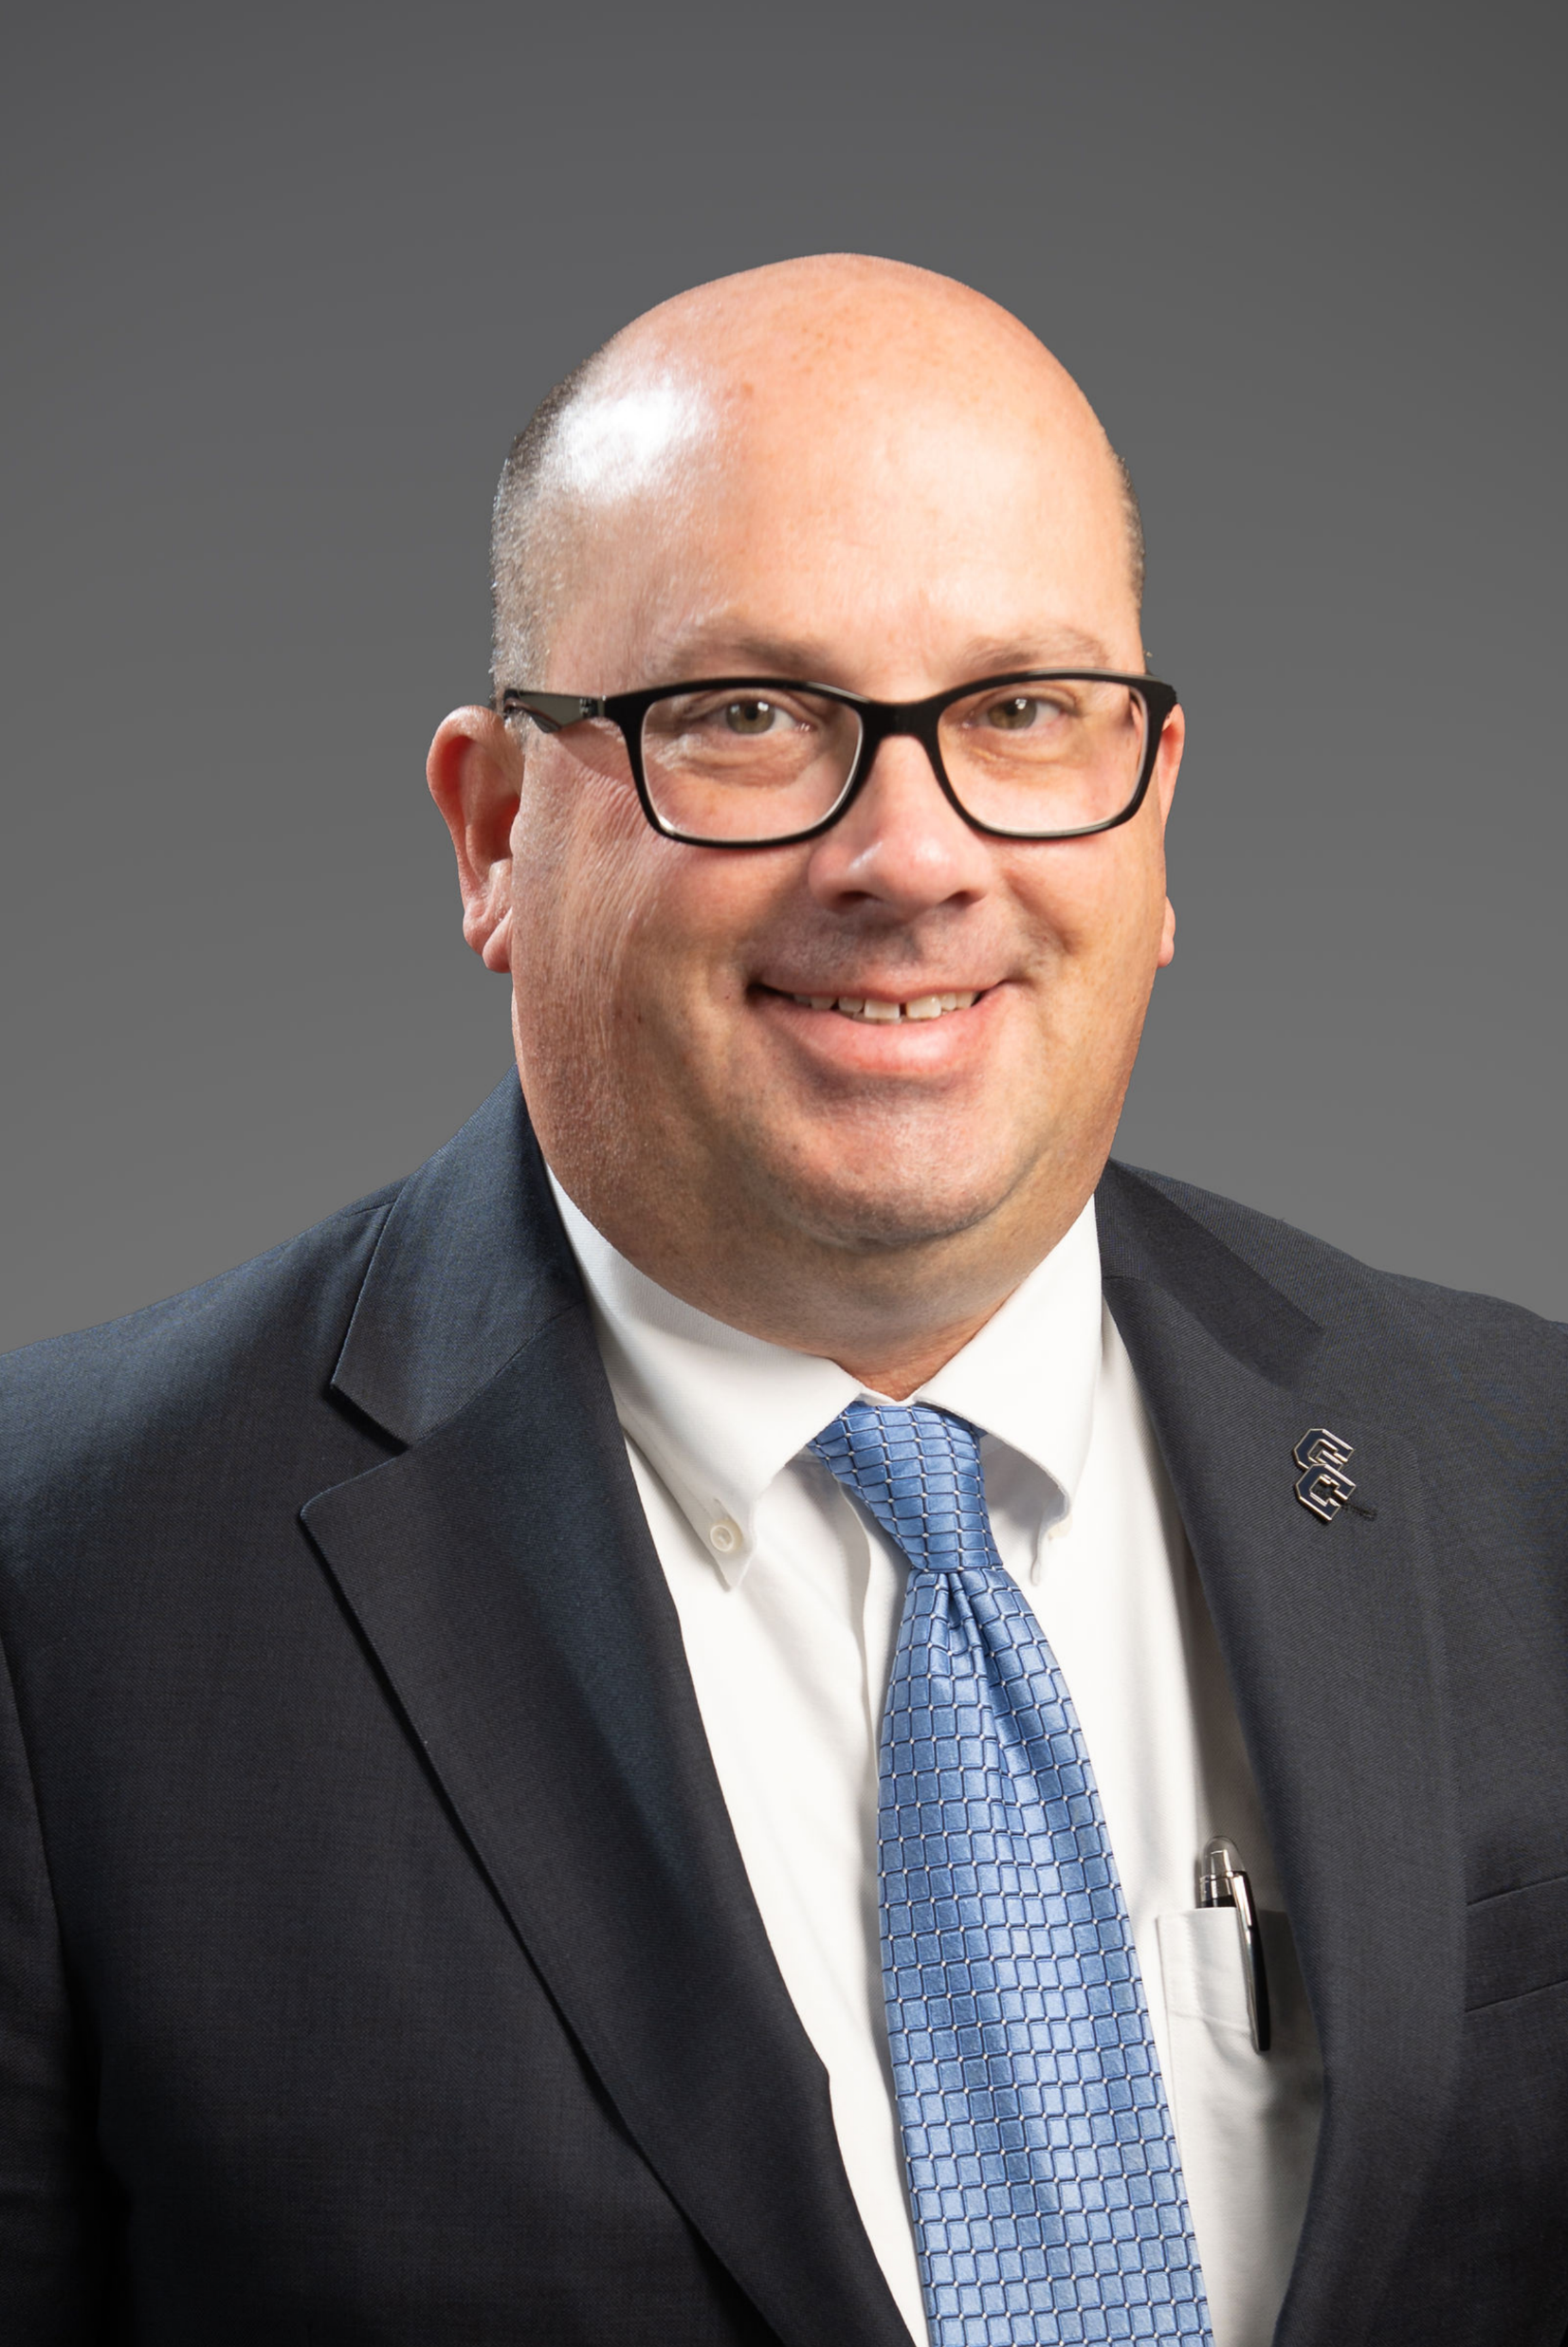
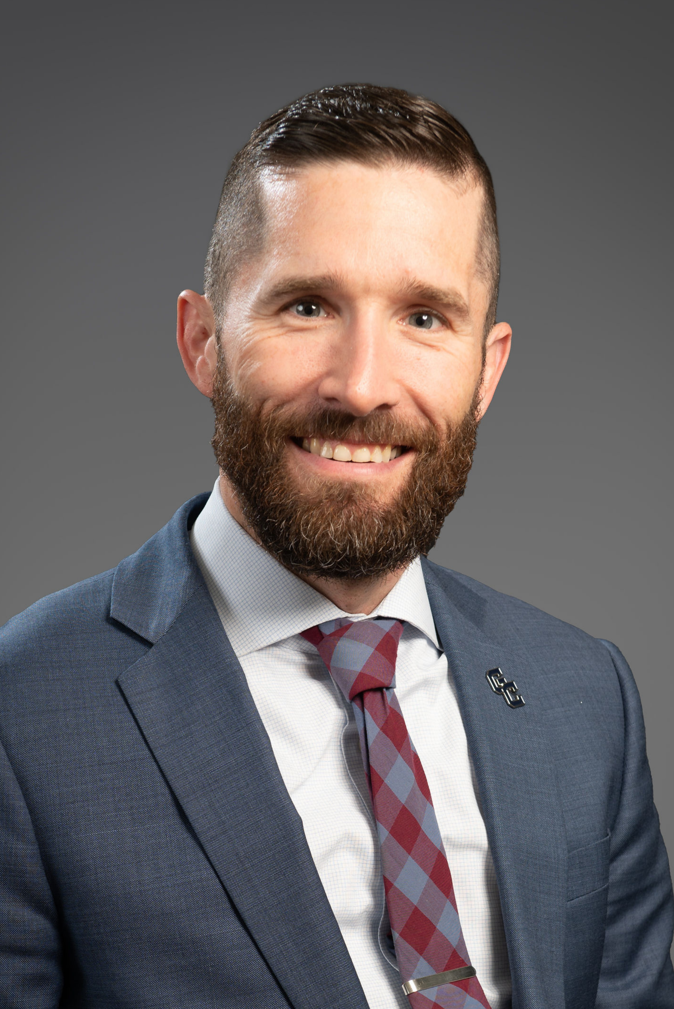
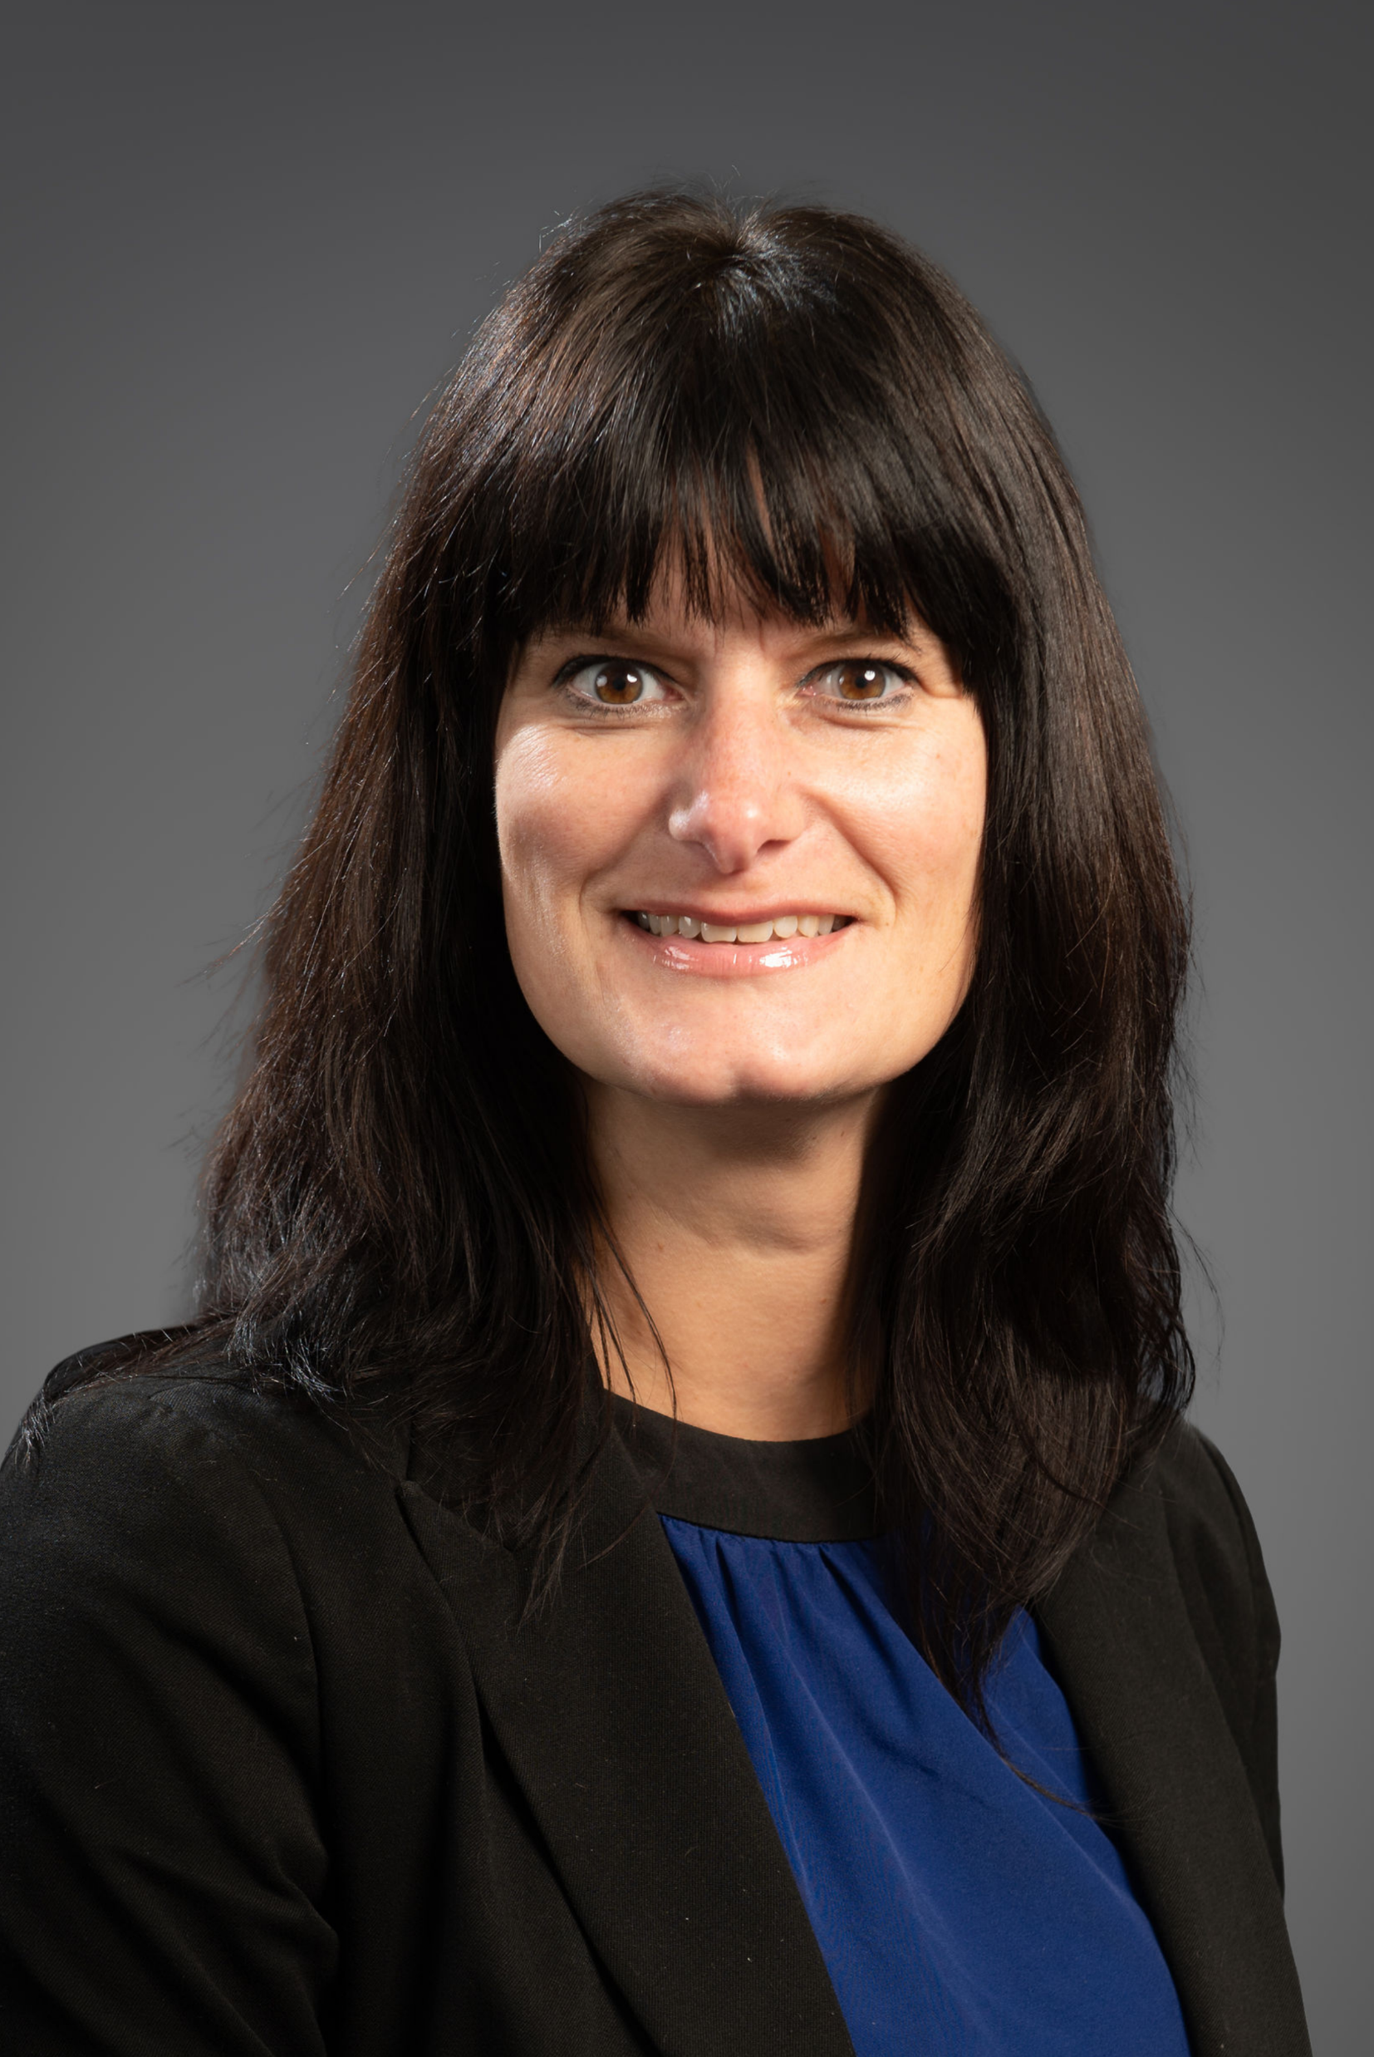
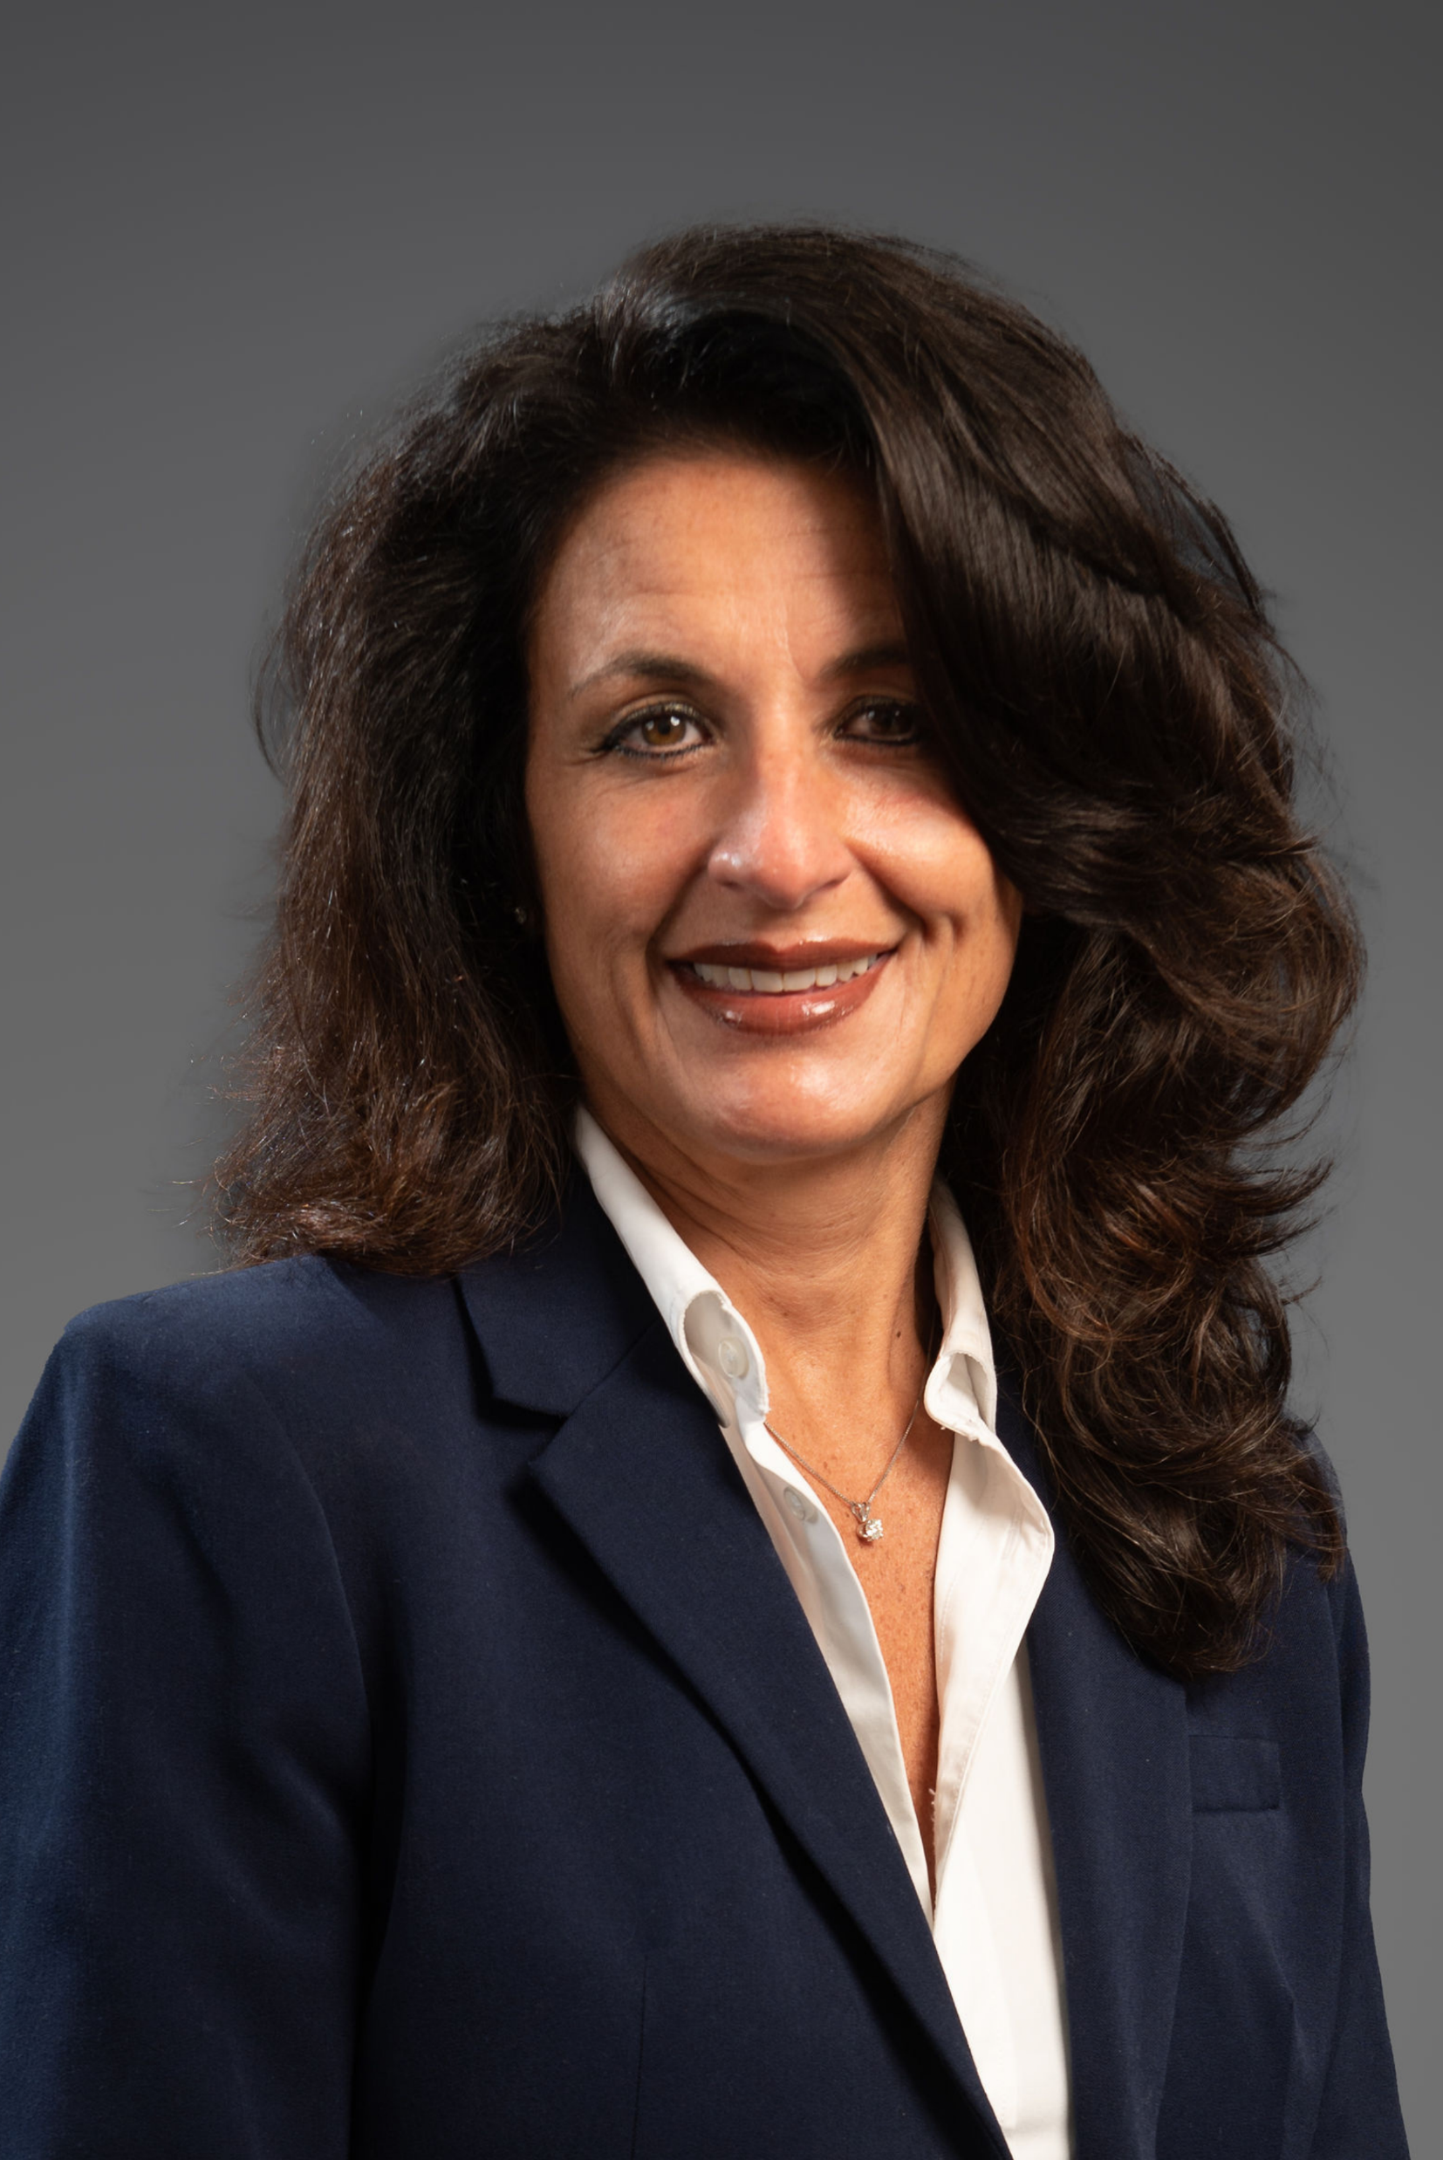
Introductions
Mr. Christopher Dailey Superintendent of Schools
Dr. Mitchell Ball Assistant Superintendent for Business
Ms. Sally Sanford
District Treasurer
Mrs. Anna Lamb Assistant School Business Administrator

Slide 4
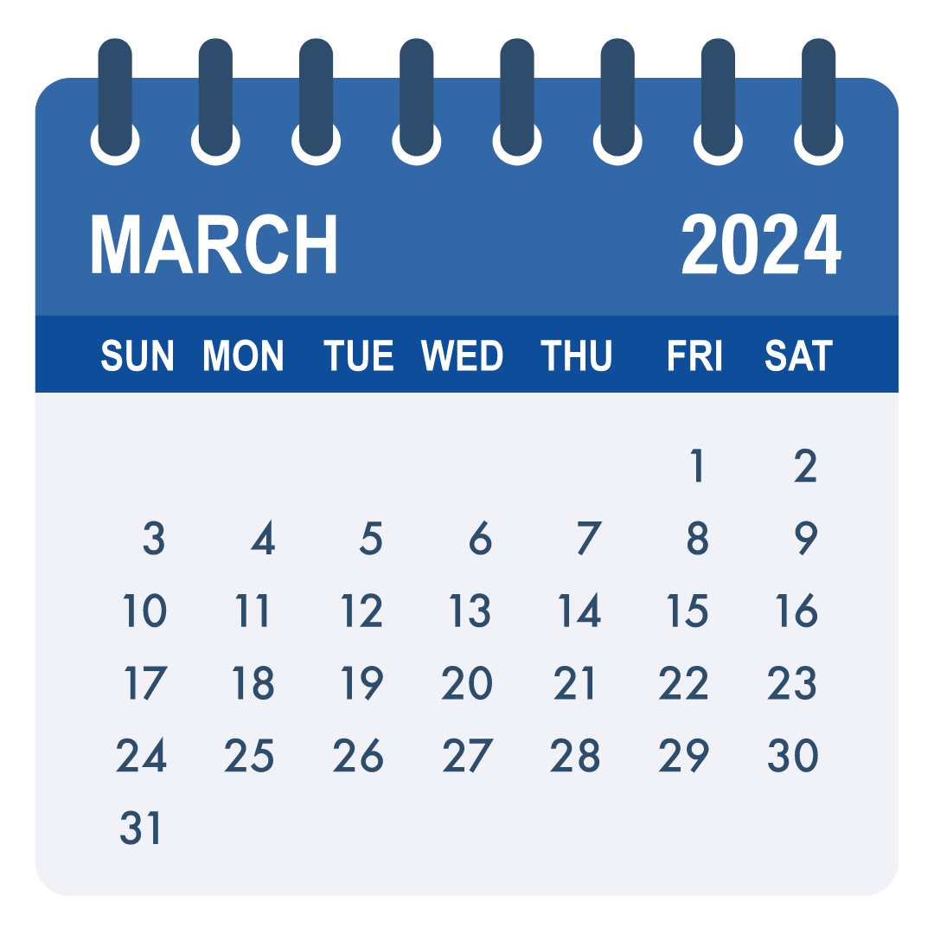
Budget Ambassador Schedule
Thursday, March 7 at 6 p.m.
District Overview, Expenditures, Payroll, Benefits, Other Expense Categories
Thursday, March 14 at 6 p.m.
Revenues, Tax Cap, Reserves, Financial Summary Charts, Budget Ambassador Survey

Slide 5
Typical Budgeting Timeline

Slide 6
Budget Calendar and Timeline
February To Mid March | Buildings and Departments' staffing budgets will be reviewed and finalized by the Executive
March 1 | Tax Levy limit calculation due
March 7 | Budget Ambassadors Workshop - Expenditures
March 14 | Budget Ambassadors Workshop - Revenues
March 18 | Budget presentation to Finance Committee
March 21 | Budget Ambassadors Workshop (if necessary)
March 26 | Budget and Revenue updates and Tax Rate projections were presented to the Board of Education. Approval of School Bus Proposition
April 16 | Budget Adoption by the Board of Education
May 7 | Public Budget Hearing and Meet the Candidates Night
May 21 | Annual Budget Vote and BOE Election 6:30 a.m. to 8:30 p.m. in the Spartan Field House at GCHS

Slide 7
About Our Students

Slide 8
Total Student Population: 3,573
11%
31%
12%
11%
24%
11%
In addition:
125 UPK students currently at Imagination Childcare Academy
Notes:
FB = 375
PR = 413
WD = 404
NA = 388
MS = 865
HS = 1128

Slide 9
Our Students
54% Economically Disadvantaged
51% White
19% Black or African-American
16% Hispanic or Latinx
10% Multiracial
6% Asian/Hawaiian/Pacific Islander
13% Students With Disabilities
5% English Language Learners (ELLs)
94.6% Districtwide Attendance Rate
Total Student
Enrollment
3,573
Notes:
Notes:
Total enrollment decrease of 40 students compared to PY BEDS day. Moderate changes from prior year as a % age.

Slide 10
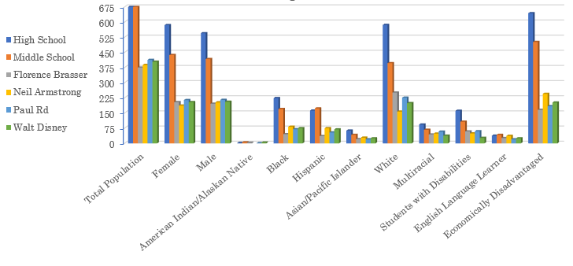
Diversity in Our Schools

Slide 11
Enrollment Projections
Notes:
Year label represents last year of school year. For Example, 2023 is 2022/2023 School Year.
Projections based on live births.

Slide 12
Student Need Indicators… on the rise
Our needs are on
the rise.
Notes:
Economic status increase = increase in poverty (not wealth). Flux due to drive to get free/reduced forms completed.

Slide 13
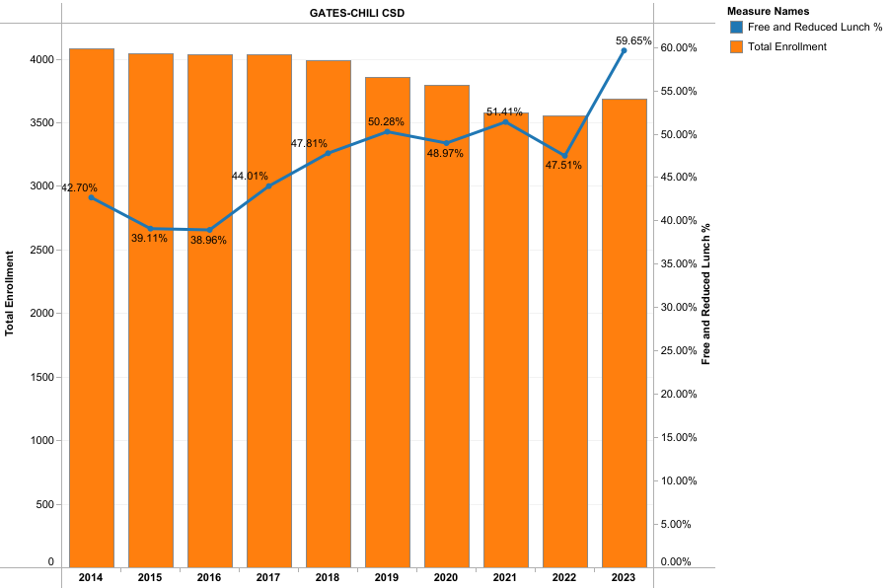
Free and Reduced Lunch Percentage
Note:
The worldwide COVID-19 pandemic impacted FRPL applications, displayed as a slight dip in 2020 over prior year. We are continuing to struggle with consistency in this area. But we do know that the needs are significant.
Notes:
Increase in economic status = increase in poverty (not wealth). Flux due to drive to get free/reduced forms completed.

Slide 14
About Our Programs

Slide 15
What Does Gates Chili Get From This Budget?
This year’s budget currently includes:
Continued mental health and behavioral support
Academic Intervention Services – Literacy and Math
Advanced Placement (AP) and Dual Enrollment courses for GCHS students
Accelerated classes for GCMS students
Post-secondary opportunities as well as college awareness
Continued Career and Technical Education programs
Continued use and maintenance of 1:1 digital devices
Maintenance and upkeep of state-of-the-art facilities available for community use
Robust professional learning for all staff
…and so much more!!

Slide 16
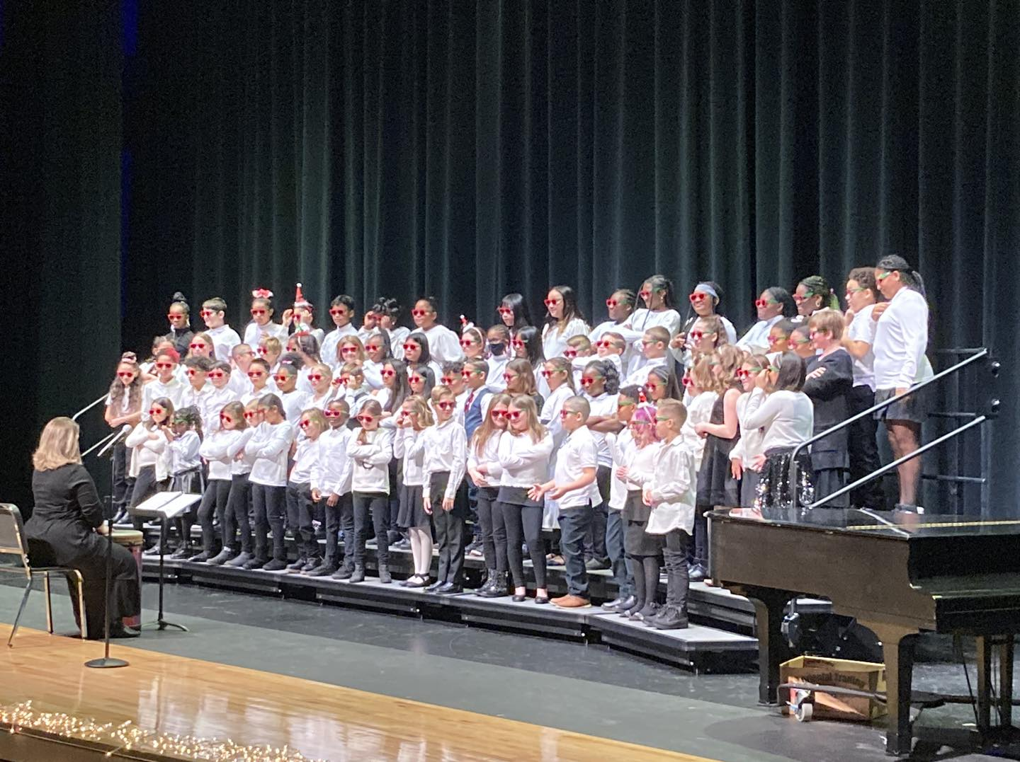
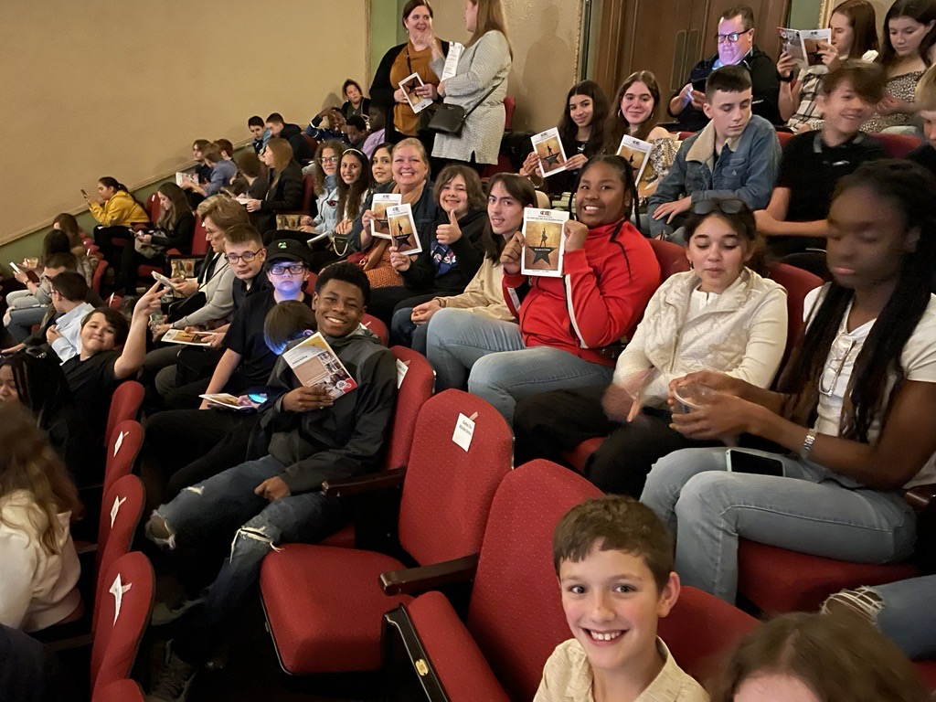
Continued Support of Non-Mandated Programs
Non-mandated programs may not be required; however, they are crucial in a child’s social and academic development and self-confidence.
Kindergarten
K-12 art classes
K-5 music program
Librarians at the elementary level
Maintains present class sizes and programs
Notes:
Performing Ensembles at every building
Bell Choir
Orchestra
Band
Chamber Ensembles
Choir
District Art Show each year to showcase our talent
High Needs District need counselors to help all students!

Slide 17
Non-Mandated ≠ Not Important
AP and college-credit courses
College and Career Center
Interscholastic athletics
Extracurricular clubs at each school
Instrumental lessons
Performing ensembles
School plays and musicals
Notes:
Performing Ensembles at every building
Bell Choir
Orchestra
Band
Chamber Ensembles
Choir
District Art Show each year to showcase our talent
High Needs District need counselors to help all students!

Slide 18
Budgeting Process

Slide 19
Typical Budgeting Types
Rollover: Taking the current year’s budget and rolling it over, adding or reducing programs and services depending on need. This is the least time-consuming type of budget and typically adds percentages to categories.
Per Pupil Allocation: Allocating based on how many students reside in the building on a certain date. Usually, high/middle schools allocated more per student than elementary level.
Modified Zero-Based: Starting from nothing and building the budget from the bottom up addressing student and staff needs.
Notes:
Rollover
Simply taking the current year budget and rolling it over, adding or reducing programs and services depending on need. This is the least time-consuming type of budget and typically adds percentages to categories.
Downsides:
Staff members spend what they get
Less community faith
Per Pupil Allocation
Every building gets an allocation based on how many students reside in the building on a certain date. Usually, high/middle schools allocated more per student than elementary level.
Downsides:
Can be problematic if there are fluctuations in student counts
Equity considerations
Modified Zero-Based
Start from nothing and build the budget from the bottom up addressing student and staff needs
Downsides:
More work by the school community
Tighter budgeting practices could lead to less flexibility

Slide 20
Predicting Expenditures
Non-staff Expense Drivers
Employee benefits
Health insurance
NYS pension plans
Utilities
Electric
Fuel
Parts
Debt Service
Principal
Interest
Staff Determination
Student enrollment
Student needs
Student programs
Contract negotiations

Slide 21
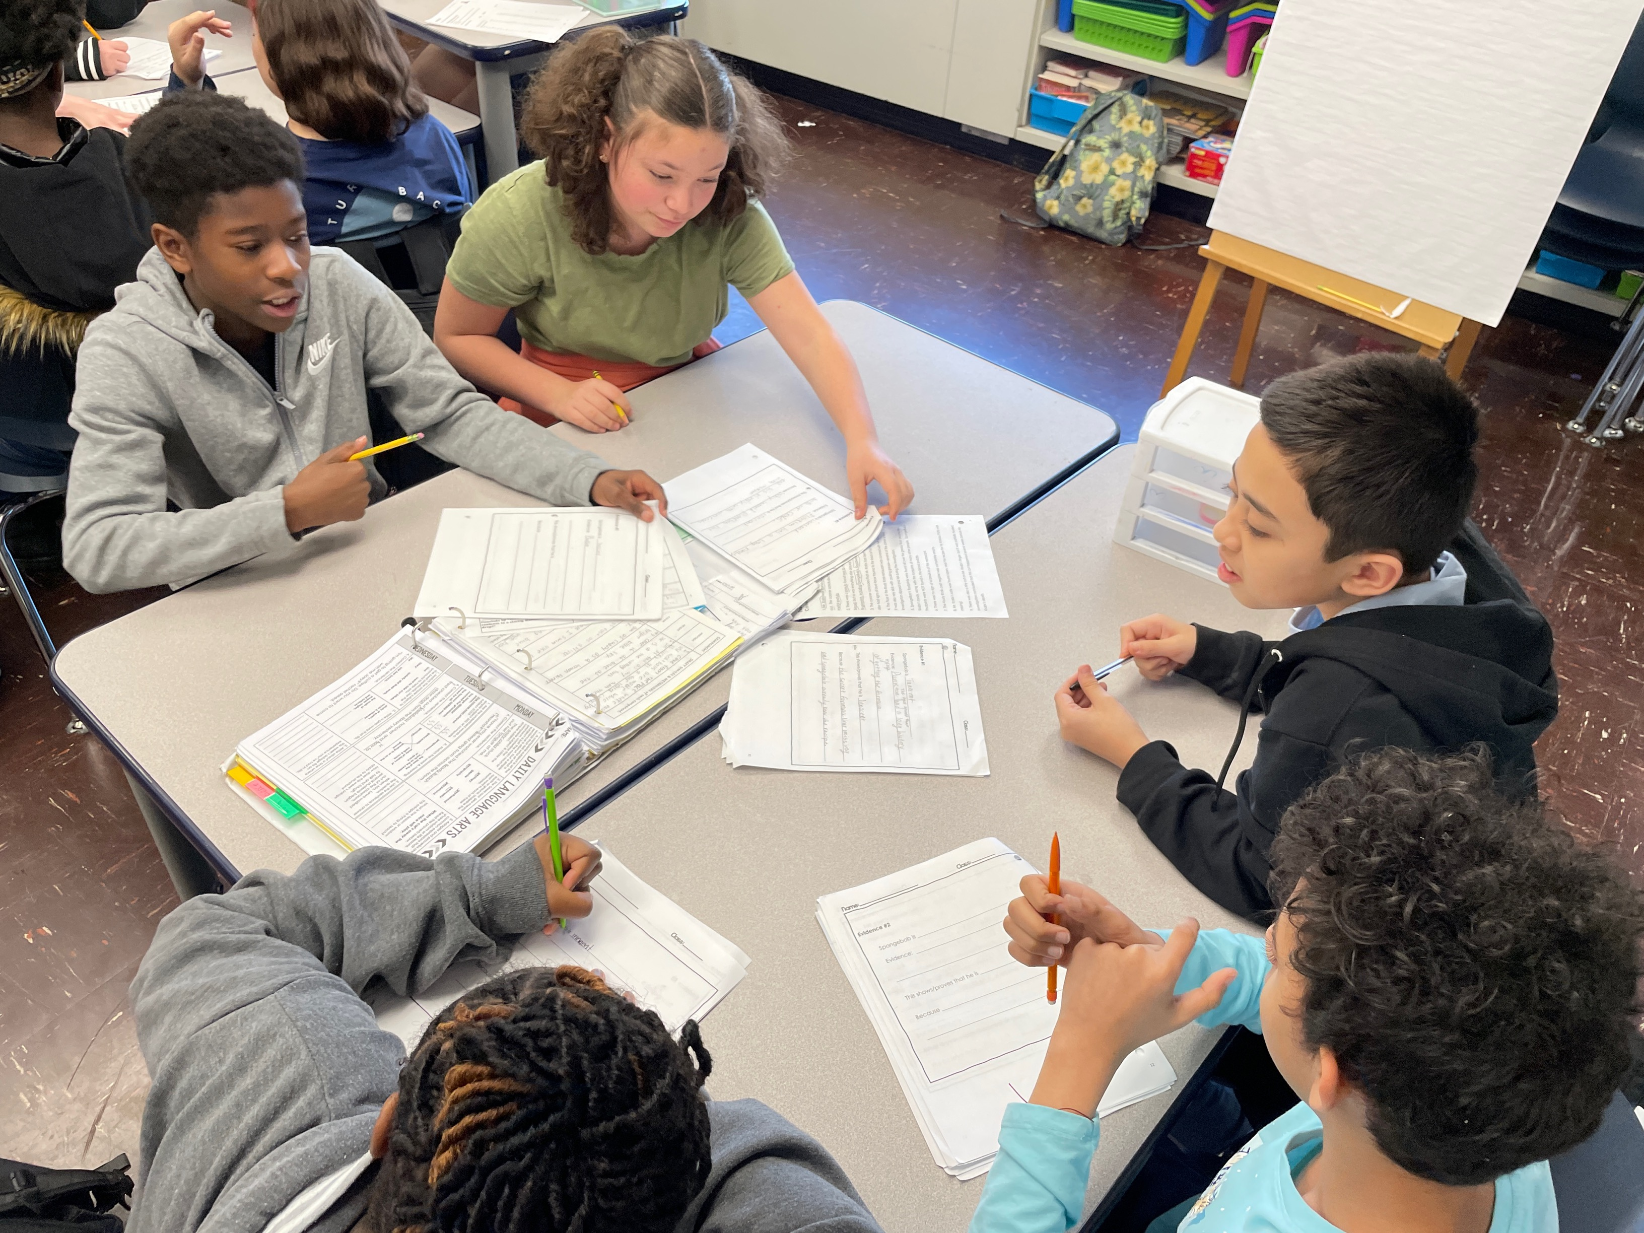
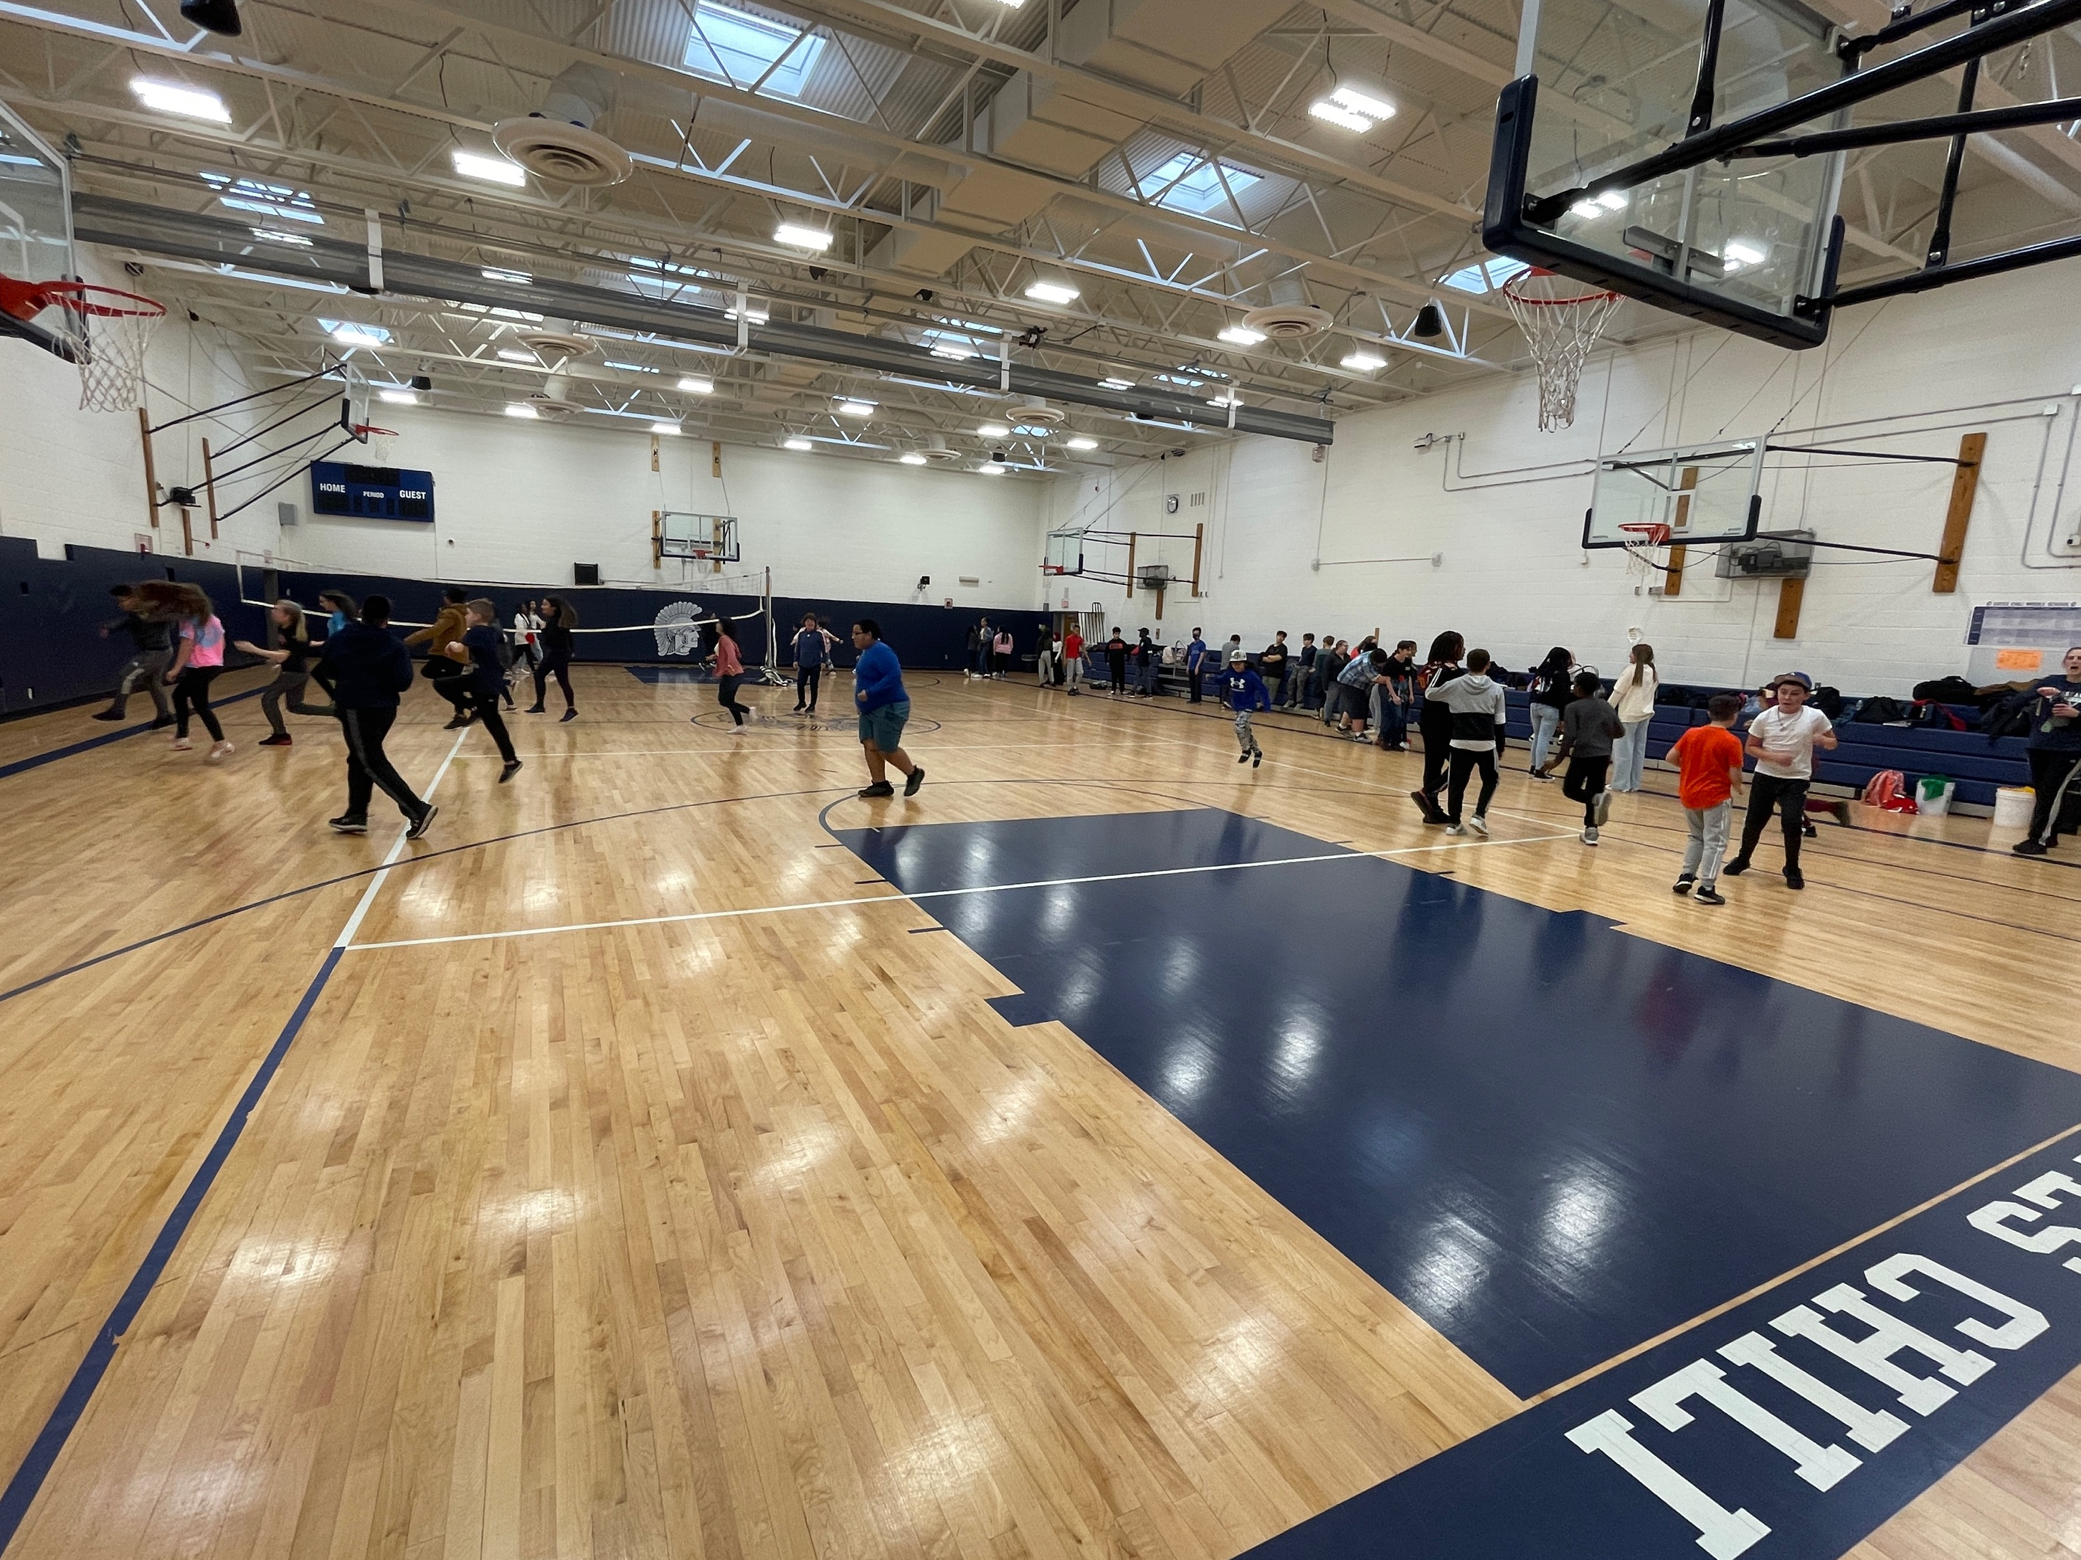
Preliminary Budget
$ 133,061,110
3.5% increase from 2023-24
Medical, Vision, and Dental Benefits
1.2% increase over last year
increase of $269,198
Lower due to switch in Medicare Advantage carrier to Aetna.
Transportation
3.25% increase over last year
Increase of $189,578
Facilities and Operations
6.17% increase over last year
Increase of $536,508
Important Notes: *Special Education still TBD
Notes:
Minimal increase in Medical Insurance due to decreasing costs related to the switch to Aetna as a carrier. Decreased Retiree Medical Insurance by $550,000

Slide 22
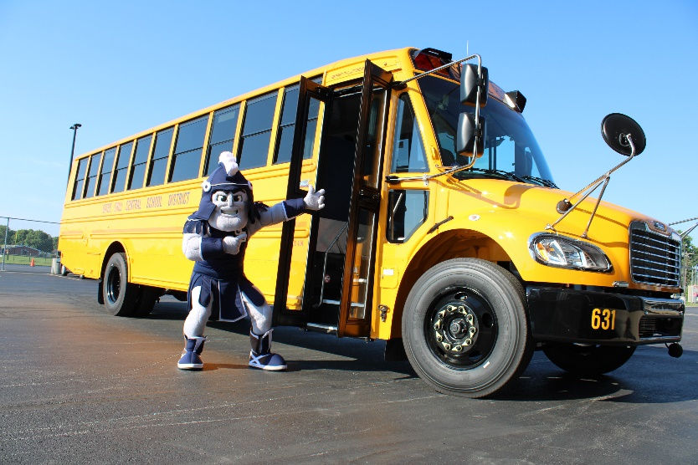
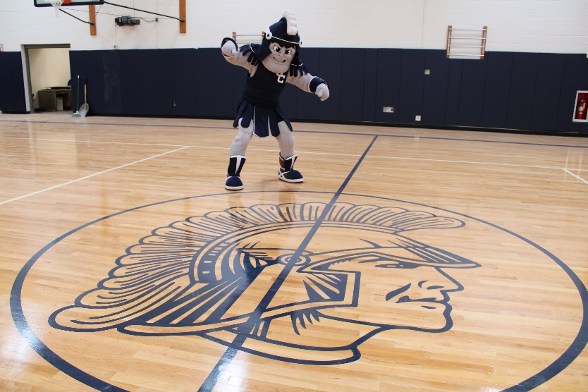
Budget Drivers Explained
Medical, Vision and Dental Benefits
Minimal increase due to Medicare Advantage carrier switch
Transportation
Special education placements
We receive aid on 74.6% of our transportation expenses
Facilities and Operations
New hire – Security Supervisor
Notes:
23-24 https://eservices.nysed.gov/publicsams/reports.do
TRANS NON-CAPITAL EXP EXCL SUM 6,942,638
TRANS CAPITAL EXP W/ SUMMER 1,282,234
2022-23 PUBLIC ENROLLMENT 3,741
# SQUARE MILES IN DISTRICT 19.674
TRANS SPARSITY ADJMT 0.00000
TR RWADA AR:1.01-(.46RWR) 0.73500
STATE SHARING RATIO 0.58400
B. STATE SHARING RATIO*1.263 0.73700
C. TR ENRL AR:1.01-(.46EWR) 0.71700
SEL TRANSPORTATION AID RATIO 0.73700

Slide 23
Expenditures WHERE DOES THE MONEY GO?
Notes:
Mitch to explain General Fund vs. other funds

Slide 24
2024-25 Budget Development Challenges
Unpredictability
Inflation: Fuel costs
Inflation: Materials, supplies, contractual services
Contractual Considerations
Contract Negotiations – 3 Bargaining Units
Market considerations
Relieving our Reliance on Appropriated Fund Balance

Slide 25
2024-25: Estimated Expenditure Budget Breakdown
Salaries and Benefits 67¢
Debt Service, Capital Outlay, Transfers 10¢
BOCES Services 12¢
Services, Tuition, Fees, Insurance 6¢
Materials, Supplies, Books 2¢
Utilities 2¢
Equipment and School Buses <1¢
Fuel <1¢
Notes:
Total 100.00% 133,061,110
Salaries & Benefits 66.46% 88,450,217
BOCES Services 12.37% 16,452,036
Debit Service, Capital Outlay, Transfers 10.17% 13,523,605
Services, Tuition, Fees, Insurance 6.52% 8,666,187
Materials, Supplies, Books 1.79% 2,375,615
Utilities 1.67% 2,223,700
Fuel 0.58% 775,000
Equipment & School Buses 0.45% 594,750.

Slide 26
2021-22 Operational Expenses
9.9%
26.9%
59.2%
Note: This slide does NOT include Debt Service
Notes:
Pie chart by function codes as follows:
General Support = 1000-1999 Including
BOE
Superintendent
Business
Legal
Personnel
Building Operation and Maintenance, Security
Central Services
BOCES Admin
Judgements, Assessment Refunds;
Instruction = 2000-2999;
Transportation = 5000-5999;
Community Service = 6000-8999
Driver’s Education
Defensive Driving
Community Education
Lifeguard, First Aid;
Employee Benefits = 9000-9099

Slide 27
2021-22 Non-Instructional Spending
5.69%
5.86%
35.85%
37.86%
11.87%
Notes:
Largest in the Special Items category is BOCES Admin.
Also included are
Liability Insurance
School Dues
Property Tax Refunds.
Legend breakdown by ARM Function:
BOE = 10XX;
Central Admin. = 12XX;
Finance = 13XX;
Staff = 14XX;
Central Services = 16XX;
Special Items = 19XX;
District Transport = 5510;
Trans. From BOCES = 5581

Slide 28
2021-22 General Fund Expenses Statewide Comparison
Key Take-away
Our spending breakdown is nearly in line with statewide averages. The largest variance is in General Support. Our General Support are lower than the statewide average as a percentage of the budget.
Note: For Gates Chili CSD, Debt Service is included in Interfund Transfers
Notes:
Our interfund transfer includes is 23.70% while the combined for state it about 4.16%.
In FY 2021/2022, the District transferred $17M to Capital for the $45.5M project from Capital Reserve in the amount of $15M and $2M from budgetary appropriations for the HS Emergency roof project.
This is skewing the %-age accordingly. Otherwise, GC would be in alignment with the rest of the state.

Slide 29
2021-22 Instructional Spending
Key Take-away:
As a percentage of total expenditures, GCCSD puts significant resources directly towards instructional programs compared other districts in the region. Federal Funds are having an impact on this chart.
GATES CHILI CSD
Notes:
Reduction in instructional funding due to ARPA/CRRSA funds used for General Fund Instructional Expense.

Slide 30
2021-22 General Fund Spending by Object Code
Notes:
GC: Personal = 36.02% NYS: Personal = 46.33%
Equipment = 0.26% Equipment = 0.55%
Contractual = 19.45% Contractual = 21.75%
Debt Service Principal = 0 Debt Service Principal = 3.68%
Debt Service Interest = 0 Debt Service Interest = 1.04%
Employee Benefits = 20.56% Employee Benefits = 22.49%
Interfund Transfers = 23.70% Interfund Transfers = 4.16%
Personal (yes, this is the spelling): salaries comes directly from ARM, not a F5 thing. All object codes that begin with .1 are reported here.
Mitch - yes this is Debt Service. However, this particular FY is when we transferred to H Capital Fund for the $15M in reserves to fund the $45.5M Capital Project plus another $2M for the Emergency Roof Project. No, most Districts pay debt P & I directly through general fund. Comptroller is trying to do away with V Debt Service Fund.

Slide 31
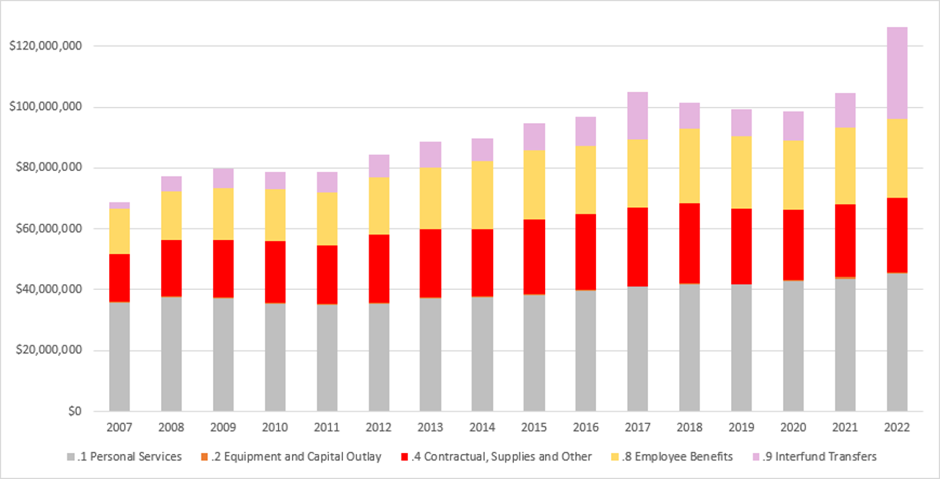
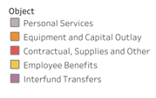
General Fund Spending by Object Code Trending
Notes:
Increased spending overall due to I/F transfer from A to H for Capital Reserves: $15M Capital Reserve + $2M Budget Appropriations.

Slide 32
Expenditures Per Building Per Student
Notes:
The exclusions include BOCES, Transportation, Tuition to Other Schools, Debt Service.
FB = 375
PR = 413
WD = 404
NA = 388
MS = 865
HS = 1128

Slide 33
Instructional Administration
Key Take-away: Regionally,
GCCSD spends in the lower half on administration.
GATES CHILI CSD

Slide 34
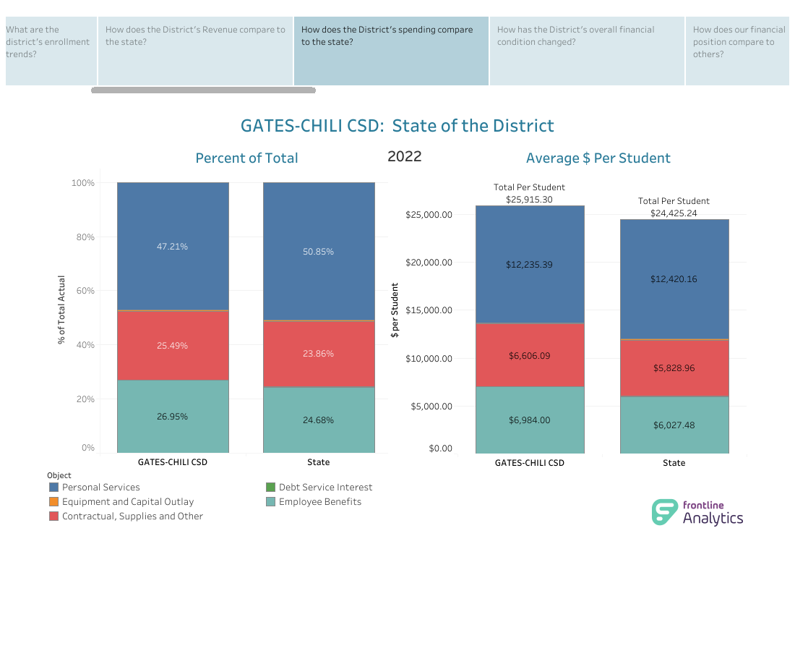
Cost per Student Comparison
Gates Chili CSD
Gates Chili CSD
Gates Chili CSD
Notes:
Personal services = ALL .1 object codes
Equipment = .2 object codes
Contractual, Supplies, other = .4 object codes
Debt Service P & I = .96 + .97 object codes
Employee Benefits = .8 object codes

Slide 35
About Our Staff

Slide 36
Active Employees and Retiree Information
Total active and retired employees: 1,991
(including substitutes)
Averages
Years of service: 9.97 years
Age: Active Employees: 46.50 years old
Age: Active Retirees: 68.46 years old

Slide 37
Active Employee Demographics
Total count: 877
Notes:
(no subs, coaches, or miscellaneous)

Slide 38
Our Staff: Breakdown by Full-Time and Part-Time
 | BATT | CAB | CAFE | CONF | CUST | EXEC | GCAA | GCTA | MECH | MGRL | SRP1 | SRP2 | SRPB | SRPC | SUPT | TDIR | TRAN | Total
Admin Bldg |  | 4 |  | 9 |  | 1 | 7 |  |  | 8 | 6 |  |  |  | 1 |  |  | 36
Facilities |  |  |  | 1 | 10 |  |  |  |  | 2 |  |  |  |  |  |  |  | 13
Florence Brasser |  |  | 3 |  | 3 |  | 2 | 53 |  |  | 1 |  | 6 | 3 |  |  |  | 71
High School |  |  | 10 |  | 26 |  | 6 | 129 |  | 4 | 11 | 1 | 16 | 2 |  |  |  | 205
Mailers |  |  |  |  |  |  |  | 5 |  | 1 |  |  |  | 1 |  |  | 1 | 8
Middle School |  |  | 10 |  | 13 |  | 4 | 96 |  | 1 | 6 |  | 18 | 5 |  |  |  | 153
Neil Armstrong |  |  | 6 |  | 4 |  | 2 | 57 |  |  | 2 |  | 13 | 3 |  |  |  | 87
Paul Road |  |  | 4 |  | 4 |  | 2 | 54 |  |  | 1 |  | 22 | 3 |  |  |  | 90
Technology Hub - HS |  |  |  |  |  |  | 1 |  |  | 2 | 5 |  |  |  |  | 1 |  | 9
Transportation | 24 |  |  | 3 |  |  |  |  | 5 | 2 |  |  |  |  |  |  | 76 | 110
Walt Disney |  |  | 6 |  | 3 |  | 2 | 56 |  |  | 2 |  | 23 | 3 |  |  |  | 95
Bargaining Unit Totals: | 24 | 4 | 39 | 13 | 63 | 1 | 26 | 450 | 5 | 20 | 34 | 1 | 98 | 20 | 1 | 1 | 77 | 877
Notes:
BATT Bus Attendant
CAB Cabinet
CAFE School Nutrition Association
COCH Coaches
CONF Confidential
CUST Custodian, Maintenance, & Security
EXEC Executive Asst to the Superintendent
GCAA Gates Chili Administrators' Association
GCTA Gates Chili Teachers' Association
MDIR Medical Director
MECH Automotive & School Bus Mechanics Assoc
MGRL Managerial
MISC Miscellaneous
SRP School Related Professionals
SRP1 School Related Professionals - A1
SRP2 School Related Professionals - A2
SRPB School Related Professionals - B
SRPC School Related Professionals - C
SUPT Superintendent
TRAN Transportation
Miscellaneous
Accompanist - Instructional
Accompanist - Non - Instructional
Bus Drivers/Attendants Covid Hrs Faclity
Co-Curricular Advisor
Continuing Education Instructor - TRS
Continuing Education Instructor - ERS
Consulting
Discretionary Benefit - LIFE
Internal Auditor
Lifeguard - Seasonal
Non-Instructional - $225/day
Recreation Supervisor PT
School Aide - Field House
Seasonal Help - Facilities
Student Helper
Seasonal Help - Mechanic
Seasonal Help - Technology Dpt
Tutor Out of District
Tutor
Water Safety Instructor

Slide 39
Our Staff: Breakdown by Type
Type of Staff | Number of staff
Instructional Staff | 460
School-related Professionals (aides and clerical support) | 153
Principals | 6
Assistant Principals | 11
Transportation | 101
Facilities/Custodial/Security/Mechanics | 68
School Nutrition | 40
District Administration | 6
Confidential/Managerial | 32
TOTAL | 877
Substitutes/Miscellaneous/Coaches​ | 382
Grand Total | 1,259
Notes:
Includes temporary employees too. 31 people difference ( active retirees included too)

Slide 40
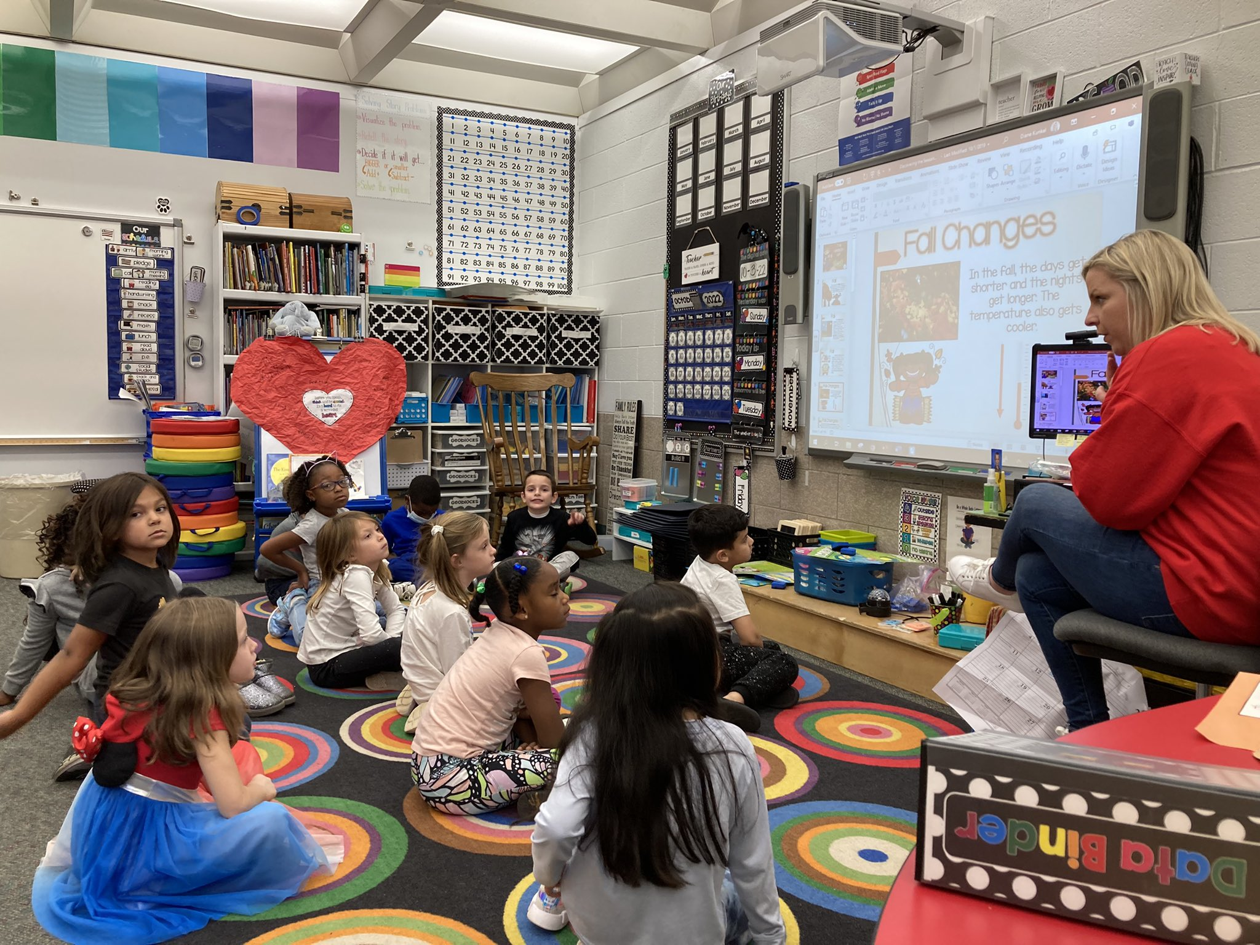
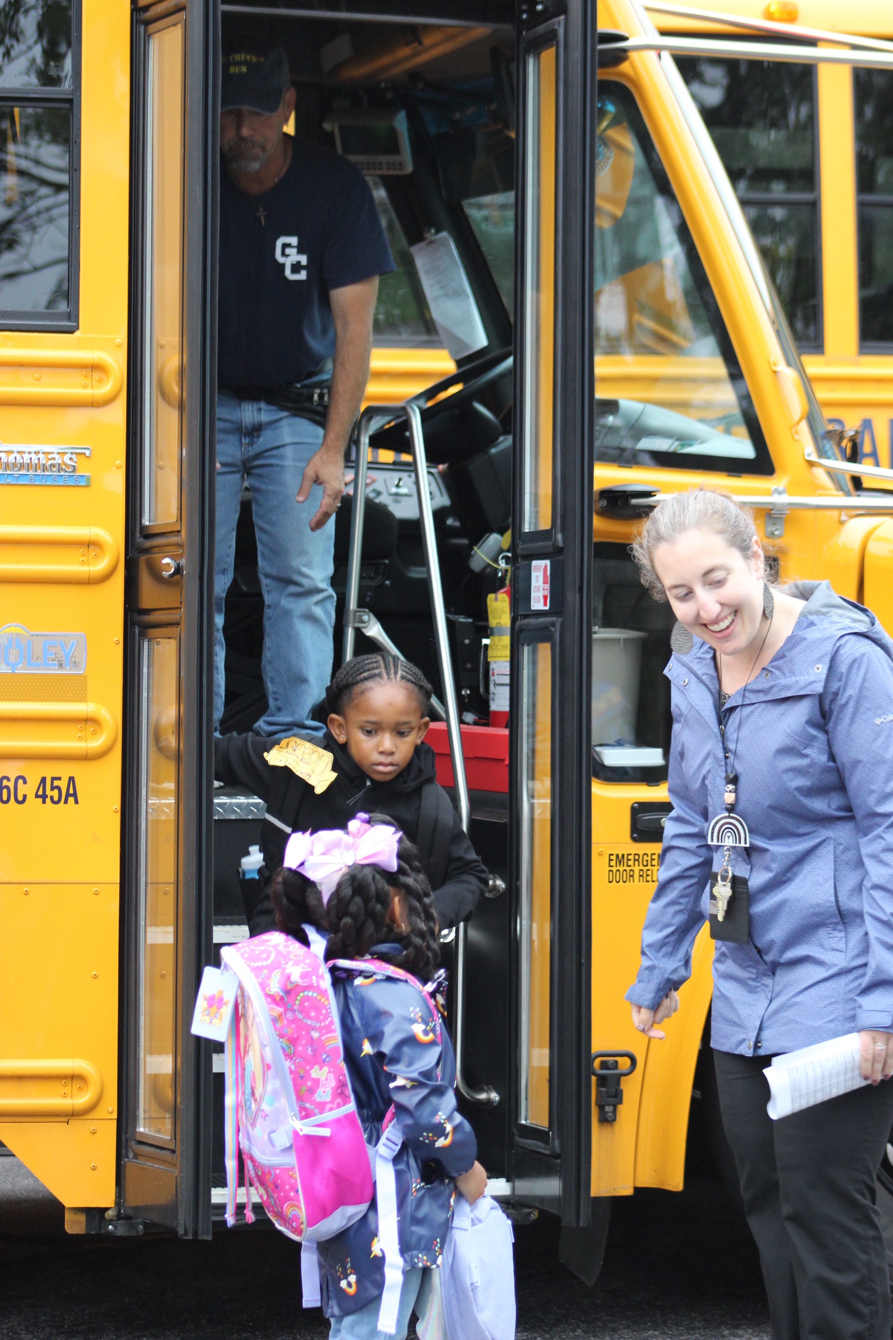
2024-25 Budgeting: Salaries
Contract Negotiations
SRP
CSEA
Transportation
All Other Contracts:
Per Agreements
Staffing conversations:
Ongoing to be completed by late March
Notes:
CONF 2025
CSEA 2024
GCAA 2024
GCTA 2026
CAFÉ 2023
MECH ended in 2022
SRP 2024
Trans 2025

Slide 41
2024-25 Contractual Salary Increases
Bargaining Unit | Salary Increase | EEs
Gates Chili Administrators’ Association (GCAA) | 3.5% | 26
Gates Chili Teacher Association (GCTA) | 3.4% +$600 | 450
Confidential / Managerial | 3.25% | 32
Custodian, Maintenance and Security (CSEA) | Negotiations | 63
Mechanics | $1.50 per hr | 5
School Nutrition | 3% | 39
School-Related Professionals | Negotiations | 153
Transportation – Bus Drivers | Negotiations | 79
Transportation – Bus Attendants | Negotiations | 27
Individual Contracts | Estimated 3.5% | 6
Notes:
Slide only includes permanent employees. Does not include most part time employees.
Also of note, all hourly employees received a $2.00 raise effective January 1, 2022, due to the continuing escalation of minimum wage and our inability to compete with the private sector.

Slide 42
BUDGETING FOR Teacher Salaries
Notes:
When reviewing this area of our budget, we will be speaking strictly to costs associated with CLASSROOM teachers. This does not include other areas like counselors, psychologists and nurses.

Slide 43
Cost of New vs Veteran Teacher
 | New Teacher | Average Teacher Salary | Most Veteran Teacher
Base Salary | $ 43,000.00 | $ 71,426.13 | $ 122,320.00
FICA | $ 2,666.00 | $ 4,428.42 | $ 7,583.84
Medicare | $ 623.50 | $ 1,035.68 | $ 1,773.64
TRS | $ 4,300.00 | $ 7,142.61 | $ 12,232.00
Health | $ 7,957.20 | $ 21,092.40 | $ 24,902.28
Dental | $ 277.64 | $ 829.36 | $ 829.36
Vision | $ 36.21 | $ 100.98 | $ 100.98
HSA | $ 1,800.00 | $ 3,600.00
HRA |  |  | $ 450.00
Total Cost | $ 60,660.55 | $ 106,055.58 | $ 165,342.15
Notes:
Used Single for the new teacher and Family for the Veteran Teacher. HCHP for New and Value for the Veteran Teacher

Slide 44
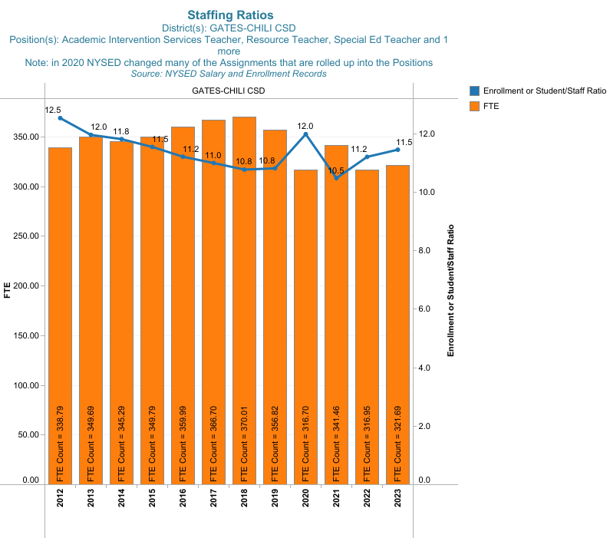
Student–to-Staff Ratios
Notes:
Staff here includes Teaching Staff Only: AIS, Special Ed, Reg. Ed. (not administration, counselors, Psych., PT, OT, Social Worker, etc.)

Slide 45
Regional Comparison: Student Per Teacher
GATES CHILI CSD – 11.45

Slide 46
Regional Comparison: Teacher Salaries
GATES CHILI CSD – $72,923

Slide 47
Student Enrollment and Teacher FTE Change
Note: Federal funding plan has impacted this.
Notes:
The housing bubble and corresponding Great Recession led to a reduction of funding to schools. At this time, the state was holding back aid to schools and in response schools were slashing programs and not filling critical positions. In aggregate, Gates Chili CSD was withheld nearly $35M over those years.
Staff snapshot taken in September. Drop in staff during COVID (September 2020), returning staff in September 2021, retirements/unfilled positions September 2022 dropping teaching staff back to COVID levels.
Historical Teacher FTE:
2019 = 357
2020 = 317
2021 = 341
2022 = 317
2023 = 322
Student enrollment snapshot taken BEDS day of each school year (first Wednesday in October). Drop in student enrollment during COVID times (remote learning, etc.). Student enrollment slowly returning to pre-COVID numbers.

Slide 48
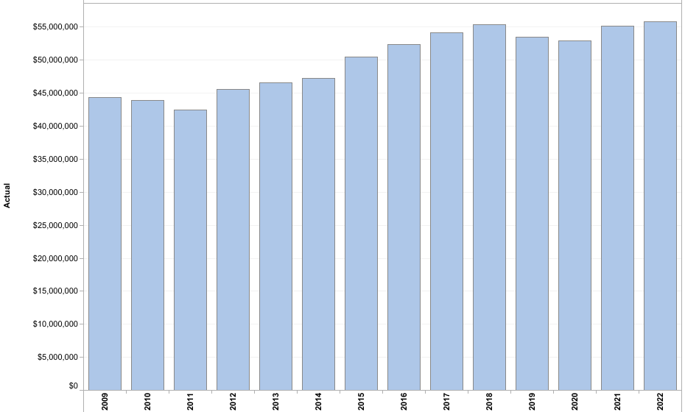
Teaching Costs Over Time

Slide 49
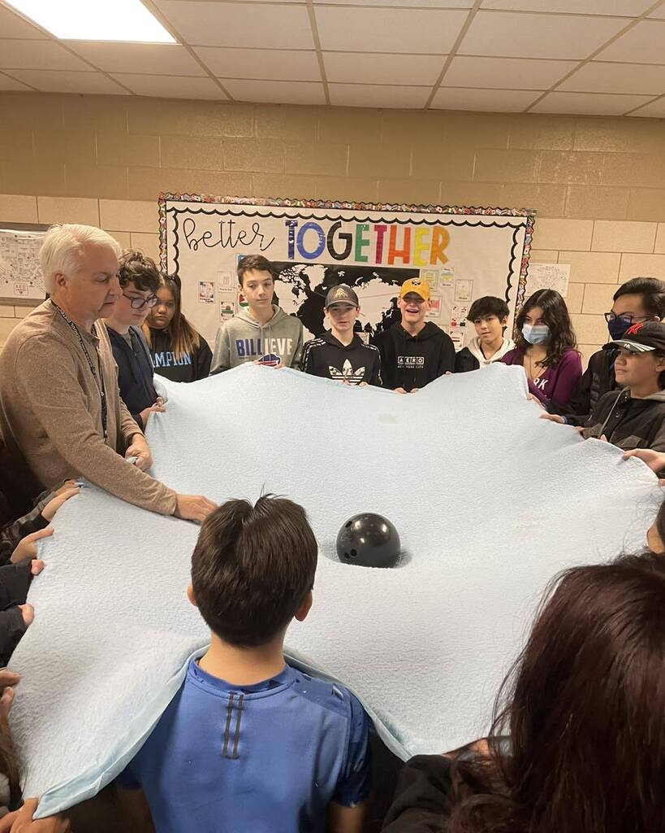
2024-25 Teacher Budget Estimate
2023-24 Budget: $ 24,312,616
2024-25 Est. Budget: $ 25,529,083
Budget increase of 5%
Percentage of overall budget: 19.19%
Notes:
Note: Percentage would be higher if Federal funded teachers were included
Object Codes 120-149 not including function codes
2825 – Social Work Services
2815 - Health Services
2820 - Psychological Services
some of 2250

Slide 50
BUDGETING FOR Student Support Staff
Notes:
Student mental health is incredibly important. This statement is true when thinking about our students generally speaking but also when thinking about student engagement with learning and overall, well being, not only for when students are in schools, but also for when they are interacting in our communities.
With this in mind, I wanted to take a minute to highlight our salaries in the areas of Counselors, Nurses, Occupational/Physical Therapists, Psychologists, and Social Workers.

Slide 51
Who are Student Support Staff?
Counselors
Nurses
Occupational Therapists
Physical Therapists
Psychologists
Social Workers

Slide 52
Student Support Ratio Over Time
Notes:
1 support staff in the category of:
School Nurse
OT
PT
Guidance Counselor
Social Worker,
School Psychologist for every 94 students.
Spike in 2019/2020 due to FTE decrease of 8 Support Staff due to Retirements: 6 School Nurses; 2 School Counselors; 2 School Psychologists.

Slide 53
Regional Comparison – Student Support Staff Ratio
GATES CHILI CSD 94.3
Notes:
This slide includes Federal Salaries. Special Fund Holds the following FTE per position in the CRRSA/ARP Funds: 1 OT; 1 PT; 2 Social Workers; 6 Counselors

Slide 54
Regional Salary Comparison – Student Support Staff
GATES CHILI CSD $65,920

Slide 55
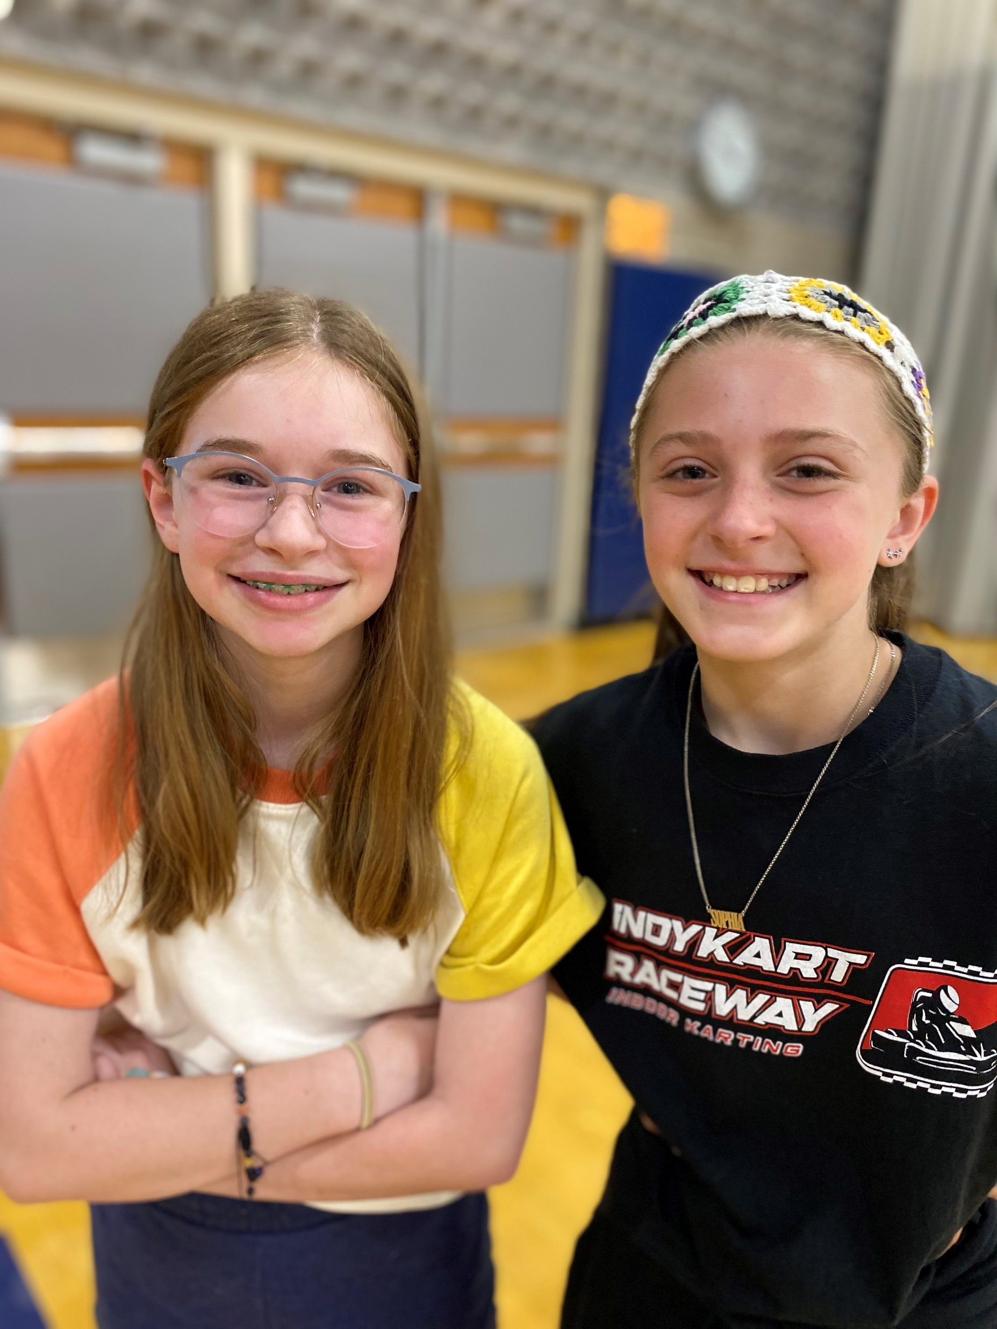
Student Support Staff Budget Estimate 2024-25
2023-24 Budget: $ 4,173,200
2024-25 Est. Budget: $ 4,607,452
Budget increase of 10.4%
Percentage of overall budget: 3.5%
Notes:
Decrease in the general fund because we shifted salaries to the federal funds CCRSA and ARP left Benefits in General
Object Codes 120-149
function codes 2825 - Social Work Services
2815 - Health Services
2820 -Psychological Services
and some of 2250

Slide 56
BUDGETING FOR Principals

Slide 57
Regional Salary Comparison – Principals
GATES CHILI CSD – $143,544
Note: Gates Chili CSD had six principals with an average age of 54. Now multiple new principals and salary will decrease.
Notes:
This are numbers from the prior year. Anticipate a drop due to retirements

Slide 58
BUDGETING FOR Benefits

Slide 59
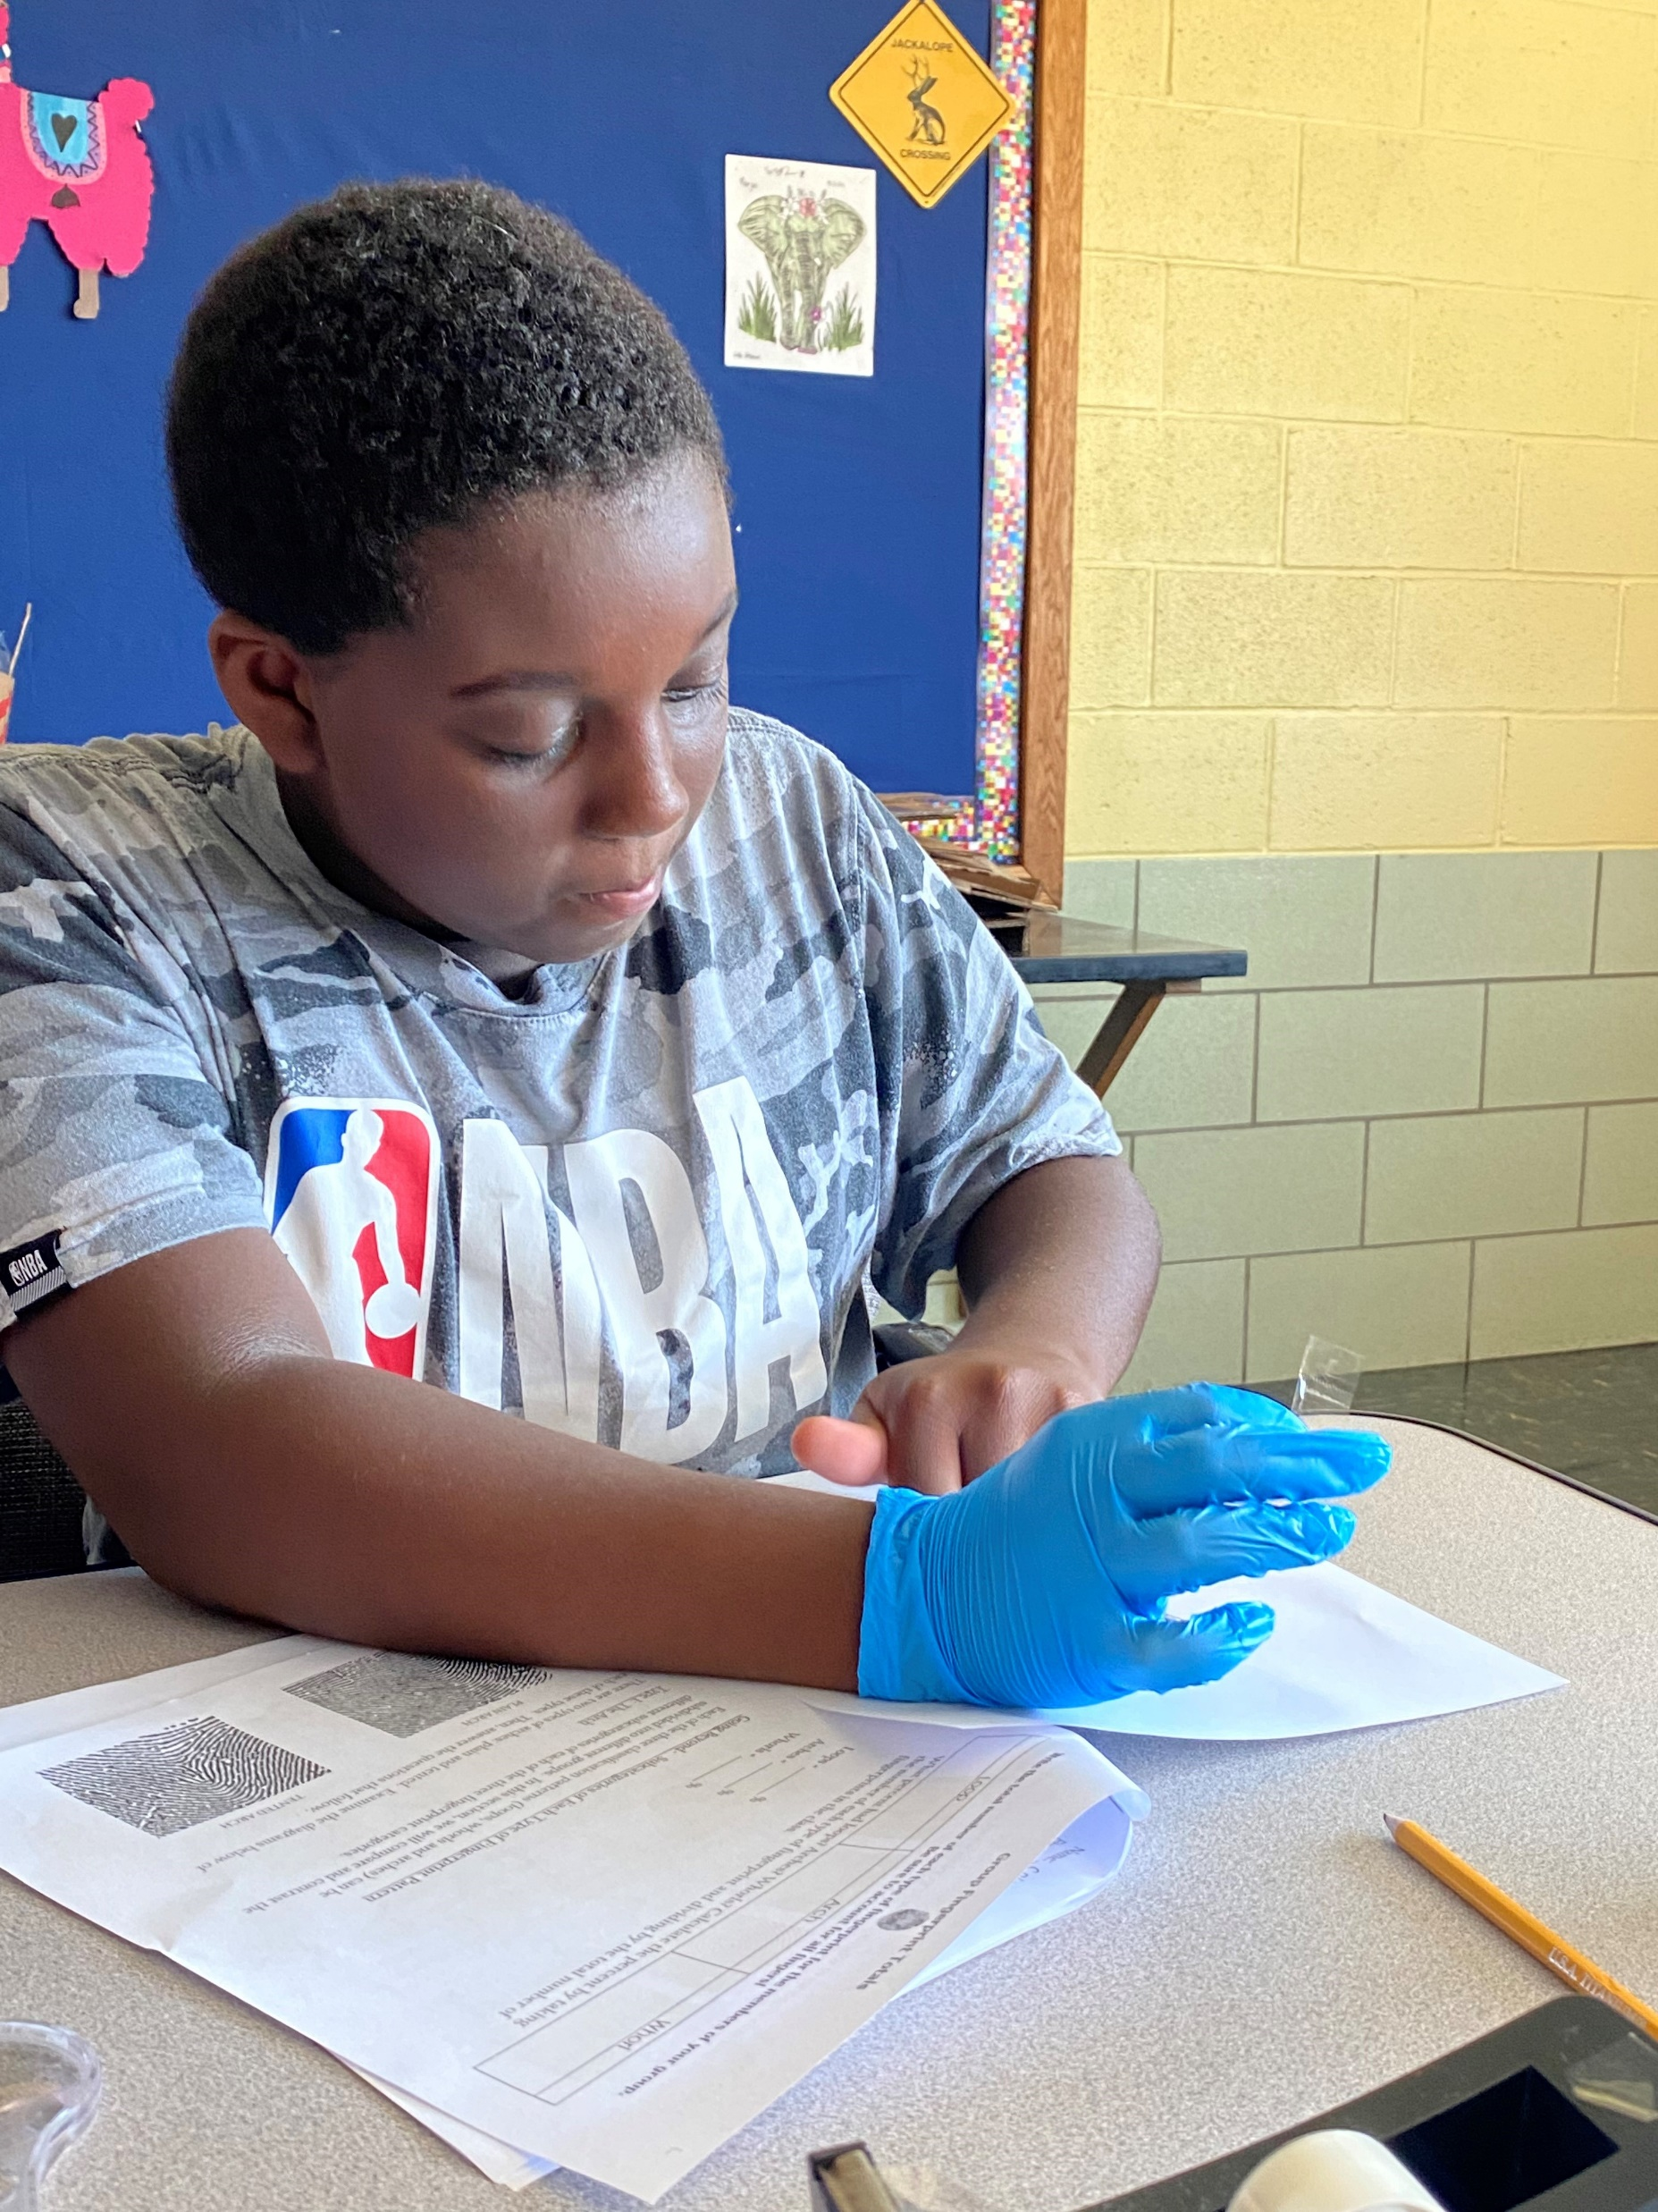
2024-25 Benefits Budget Factors
Teacher Retirement System rate
Est. equal to 10.25% of salaries
Employee Retirement System rate
Est. equal to 13% of salaries
Health Insurance rate
Increase of 10.0%
Dental Insurance rate
Increase 5%
Vision Insurance rate
No increase
Notes:
Health Insurance – Retiree Medical – Medicare Advantage plan decreased prem.

Slide 60
2024-2025 Benefits Budget Factors Increased by: $318,657
Notes:
Decrease consists of Retiree Medical

Slide 61
Other Benefits
Total: $5,010,000
Decreased by: $25,001
Notes:
Decrease of $250,000 Workers’ Comp
23-24 $950,000
24-25 $700,000

Slide 62
Employee Participation in Benefit Plans

Slide 63
Benefit Plans – Cost to District
Bargaining Units |  | Single | Family | Sponsor | Family 1 Adult
Gates Chili Administrators' Association
Confidential & Managerial
 | Dental Insurance | 277.64 | 829.36 | 829.36 | 829.36
 | Value | 9,285.70 | 24,609.31 | 22,285.87 | 21,357.50
 | High Deductible Health Plan | 7,559.34 | 20,037.78 | 18,141.96 | 17,386.14
 | Vision Insurance | 36.21 | 100.98 | 68.75
 | Health Reimbursement Account | 150.00 | 450.00 | 300.00 | 450.00
 | Health Savings Account | 1,700.00 | 3,400.00 | 3,400.00 | 3,400.00
 | Opt-Out of Health Insurance | 3,000.00 | 3,000.00 | 3,000.00 | 3,000.00
 | Opt-Out Spouse works for District | 600.00 | 600.00 | 600.00 | 600.00
Administrators with Individual Contracts (changes from above)
 | Health Savings Account | 1,800.00 | 3,600.00 | 3,600.00 | 3,600.00
 | Health Reimbursement Account | 1,500.00 | 1,500.00 | 1,500.00 | 1,500.00
 | Opt-Out of Health Insurance | 3,250.00 | 3,250.00 | 3,250.00 | 3,250.00

Slide 64
Benefit Plans – Cost to District(cont’d)
Bargaining Units |  | Single | Family | Sponsor | Family 1 Adult
Gates Chili Teachers Association
 | Dental Insurance | 277.64 | 829.36 | 829.36 | 829.36
 | Value | 9,396.24 | 24,902.28 | 22,551.18 | 21,611.76
 | High Deductible Health Plan | 7,957.20 | 21,092.40 | 19,096.80 | 18,301.20
 | High Deductible Health Plan Year 3+ | 7,559.34 | 20,037.78 | 18,141.96 | 17,386.14
 | Select - NO New Enrollees | 9,396.24 | 24,902.28 | 22,551.18 | 21,611.76
 | Major Medical - NO New Enrollees | 556.62 | 1,393.62
 | Vision Insurance | 36.21 | 100.98 | 68.75
 | Health Reimbursement Account | 150.00 | 450.00 | 300.00
 | Health Savings Account | 1,800.00 | 3,600.00
 | Health Savings Account Year 3+ | 900.00 | 1,800.00
 | Major Medical Opt Out of Health Insurance | 625.00 | 1,550.00
 | Opt Out of Health Insurance | 2,125.00 | 3,250.00 | 600.00
Building Substitute Teacher
 | High Deductible Health Plan | 7,161.48 | 18,983.16 | 17,187.12 | 16,471.08
 | Health Savings Account | 1,800.00 | 3,600.00

Slide 65
Benefit Plans – Cost to District(cont’d)
Bargaining Units |  | Single | Family | Sponsor | Family 1 Adult
Custodial, Maintenance & Security
 | Dental Insurance | 261.31 | 780.58 | 780.58 | 780.58
 | Value | 9,396.24 | 24,902.28 | 22,551.18 | 21,611.76
 | High Deductible Health Plan | 7,957.20 | 21,092.40 | 19,096.80 | 18,301.20
 | Vision Insurance | - | - | -
 | Health Savings Account | 1,700.00 | 3,400.00
 | Opt-Out of Health Insurance | 1,500.00 | 3,000.00 | 600.00
 | Opt-Out Spouse works for District | 600.00 | 600.00 | 600.00 | 600.00
Automotive & School Bus Mechanics
 | Dental Insurance | 261.31 | 780.58 | 780.58 | 780.58
 | Value | 9,396.24 | 24,902.28 | 22,551.18 | 21,611.76
 | High Deductible Health Plan | 7,161.48 | 18,983.16 | 17,187.12 | 16,471.08
 | Vision Insurance | - | - | -
 | Health Reimbursement Account | 200.00 | 600.00 | 400.00 | 600.00
 | Health Savings Account | 1,700.00 | 3,400.00 | -
 | Opt-Out of Health Insurance |  | 3,000.00
 | Opt-Out Spouse works for District | 600.00 | 600.00 | 600.00 | 600.00
Transportation
 | Dental Insurance | 250.00 | 250.00 | 250.00 | 250.00
 | Value | 9,396.24 | 24,902.28 | 22,551.18 | 21,611.76
 | High Deductible Health Plan | 7,559.34 | 20,037.78 | 18,141.96 | 17,386.14
 | Health Savings Account | 1,700.00 | 3,400.00
 | Vision Insurance | - | - | -
 | Opt-Out of Health Insurance | 2,000.00 | 3,000.00
 | Opt-Out Spouse works for District | 600.00 | 600.00 | 600.00 | 600.00

Slide 66
Benefit Plans – Cost to District(cont’d)
Bargaining Units |  | Single | Family | Sponsor | Family 1 Adult
School-Related Professionals
 | Dental Insurance | 250.00 | 500.00 | 500.00 | 500.00
 | Value | 9,285.70 | 24,609.31 | 22,285.87 | 21,357.50
 | High Deductible Health Plan | 7,559.34 | 20,037.78 | 18,141.96 | 17,386.14
 | Vision Insurance | - | - | -
 | Health Savings Account | 1,700.00 | 3,400.00
 | Opt-Out of Health Insurance | 2,000.00 | 3,000.00 | 600.00
School Nutrition
 | Dental Insurance | 250.00 | 250.00 | 250.00 | 250.00
 | Value | 9,396.24 | 24,902.28 | 22,551.18 | 21,611.76
 | High Deductible Health Plan | 7,400.20 | 19,615.93 | 17,760.02 | 17,020.12
 | Vision Insurance | - | - | -
 | Health Reimbursement Account | 100.00 | 300.00 | 200.00
 | Health Savings Account | 1,700.00 | 3,400.00
 | Health Savings Account - Year 3+ | 850.00 | 1,700.00
 | Opt-Out of Health Insurance |  | 1,000.00

Slide 67
Salary and Benefits Summaries

Slide 68
Regional Comparison: Salaries and Benefits
GATES CHILI CSD

Slide 69
BUDGETING FOR Other Expenses

Slide 70
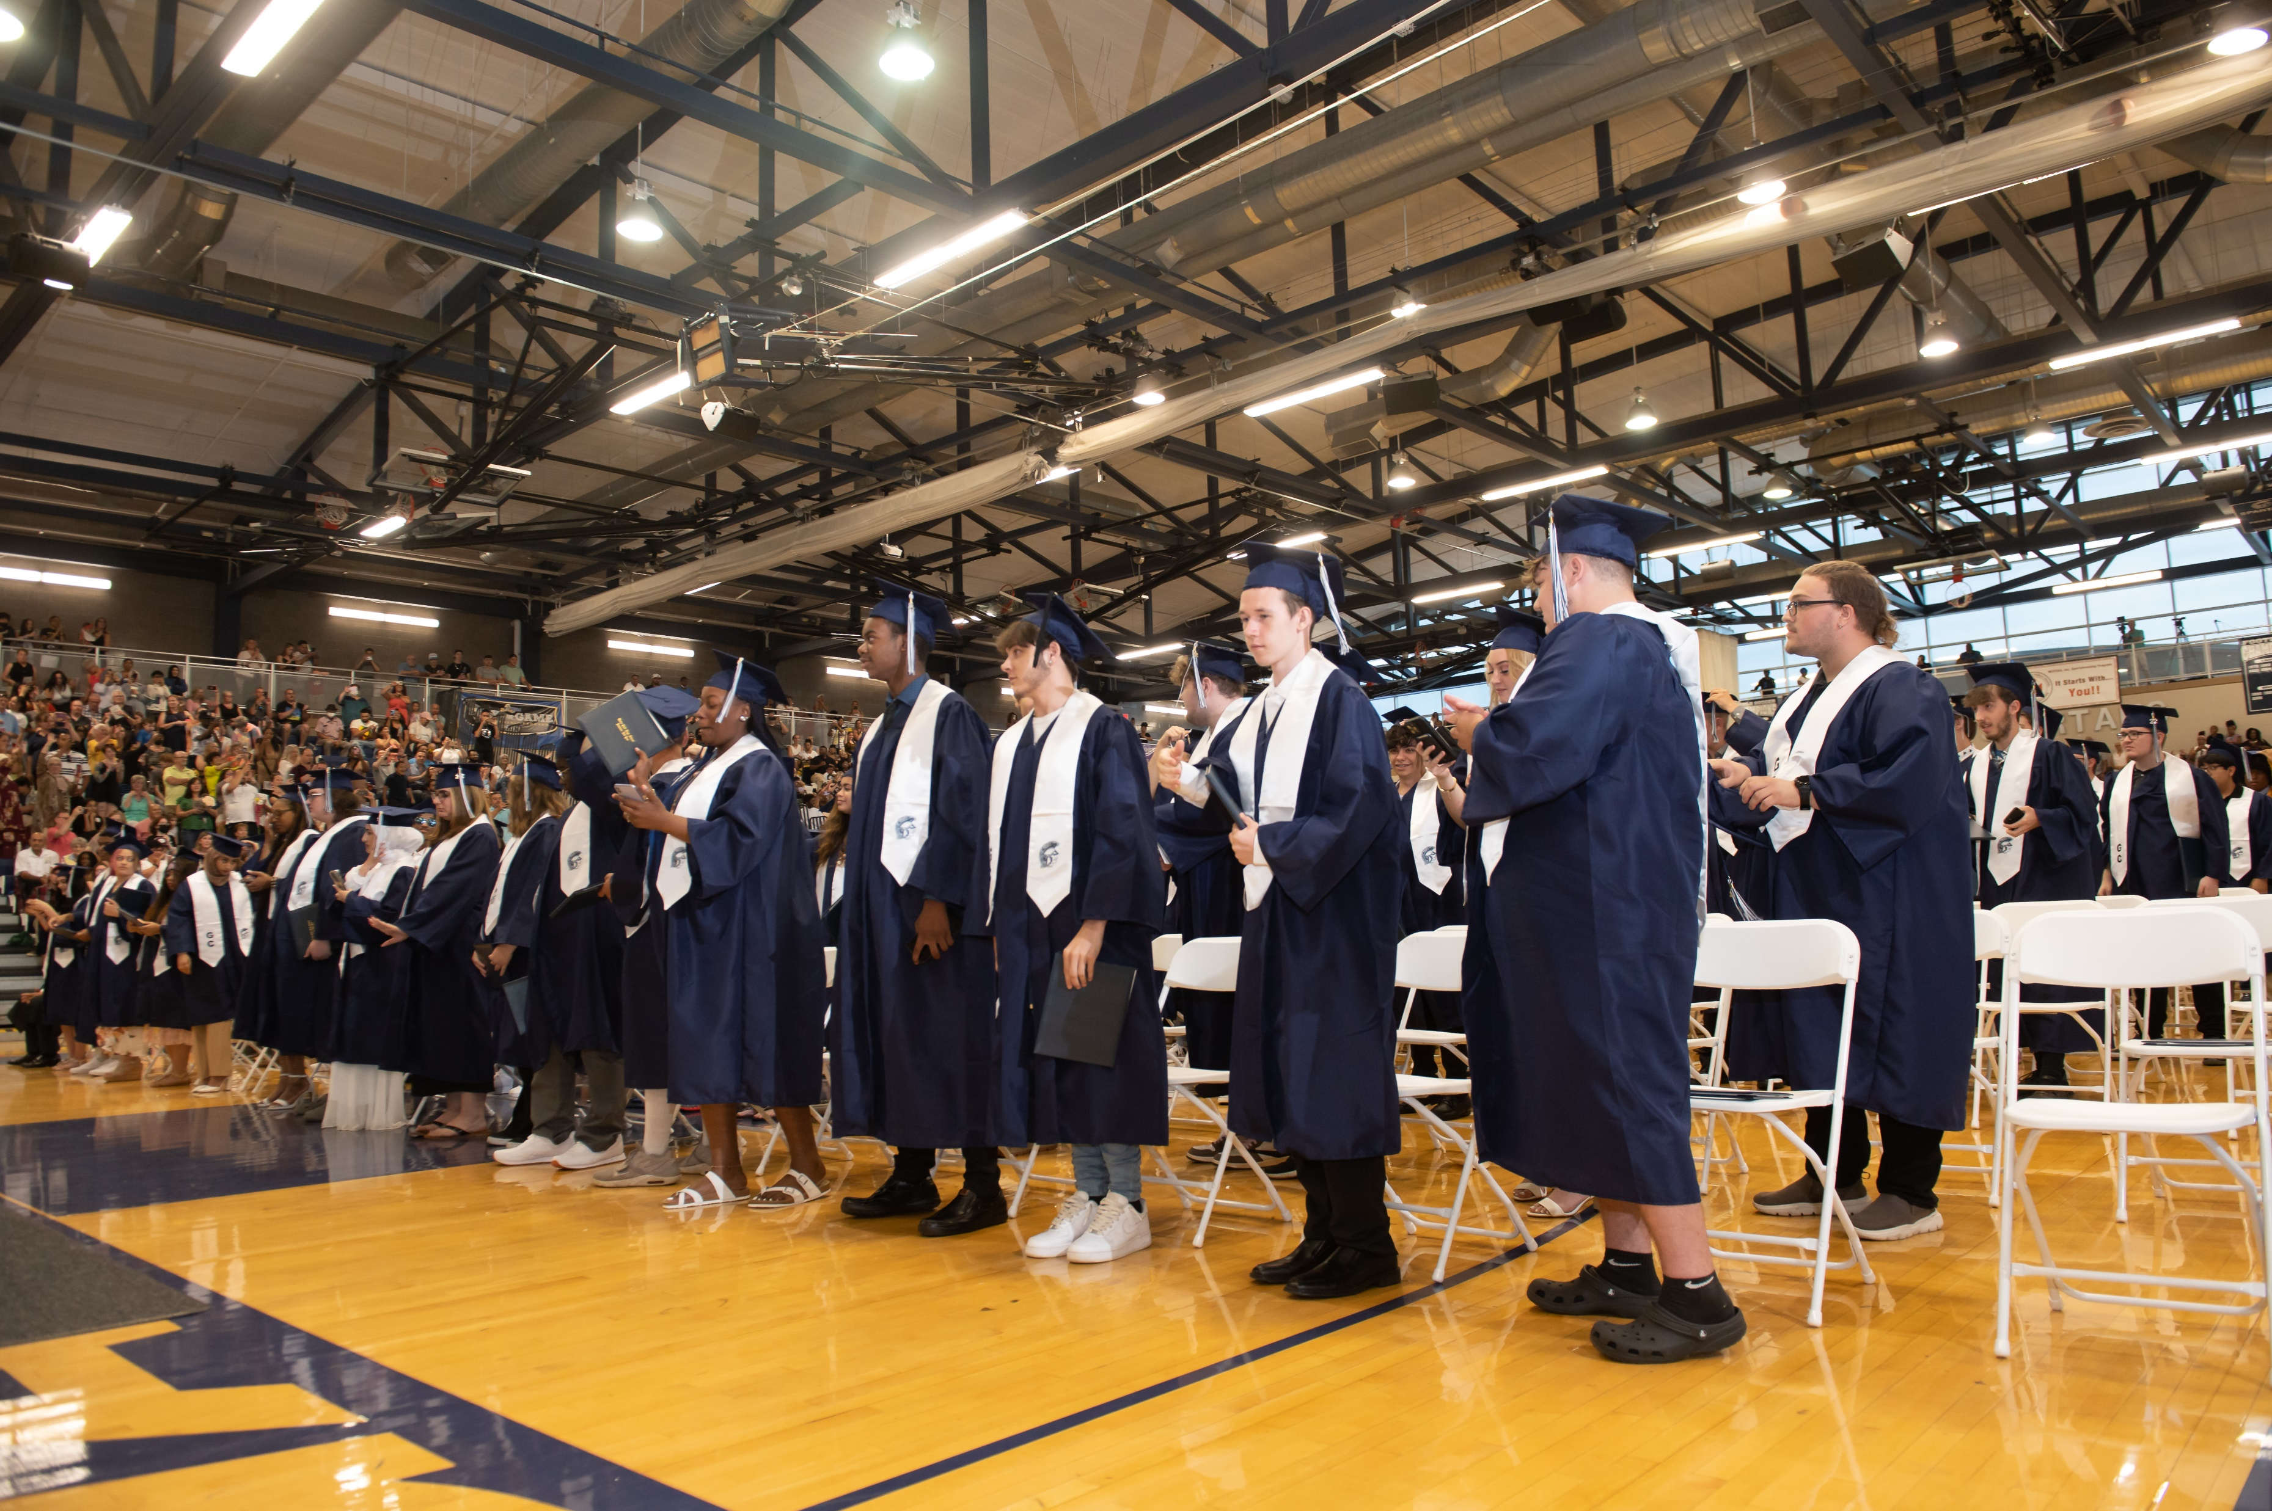
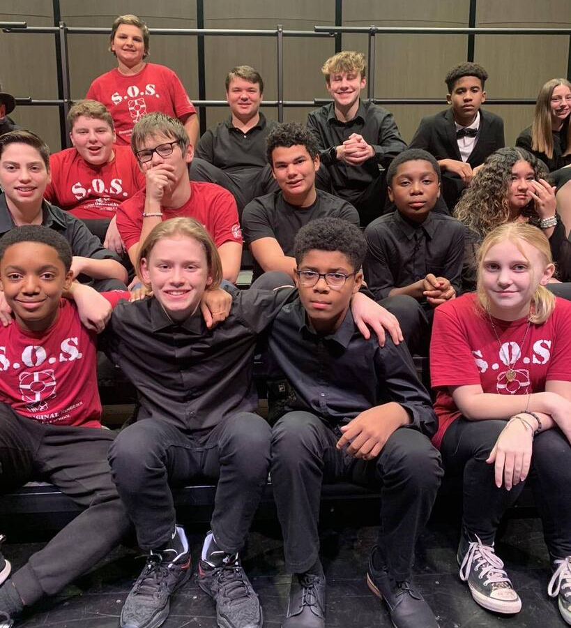
Supplies, Materials, Contractual
Budgets for supplies, materials, and contracts are all nearly finalized
Incredible job by building-level and department minimal increase from prior year
Note: 2023 CPI-U = 4.12%
Notes:
Called John at Questar he stated the CPI-U = 4.12% which different that the DOL rate which is 3.4%
US Core Inflation Rate Remains Steady at 4% The annual core consumer price inflation rate in the United States, which excludes volatile items such as food and energy, stood at an over two-year low of 4% in November 2023, unchanged from October, matching market forecasts.
3.4% increase from December 2022 to December 2023
Food prices increased 2.7%

Slide 71
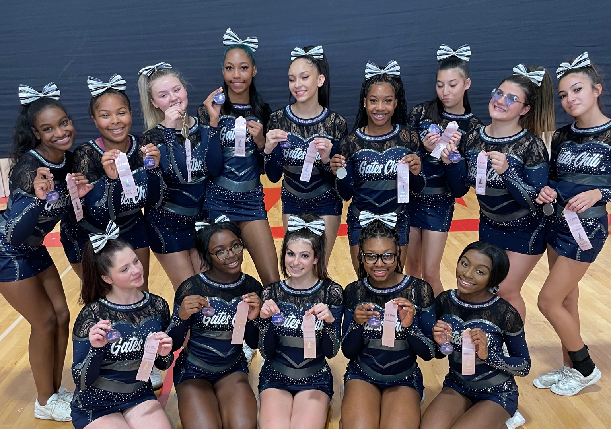
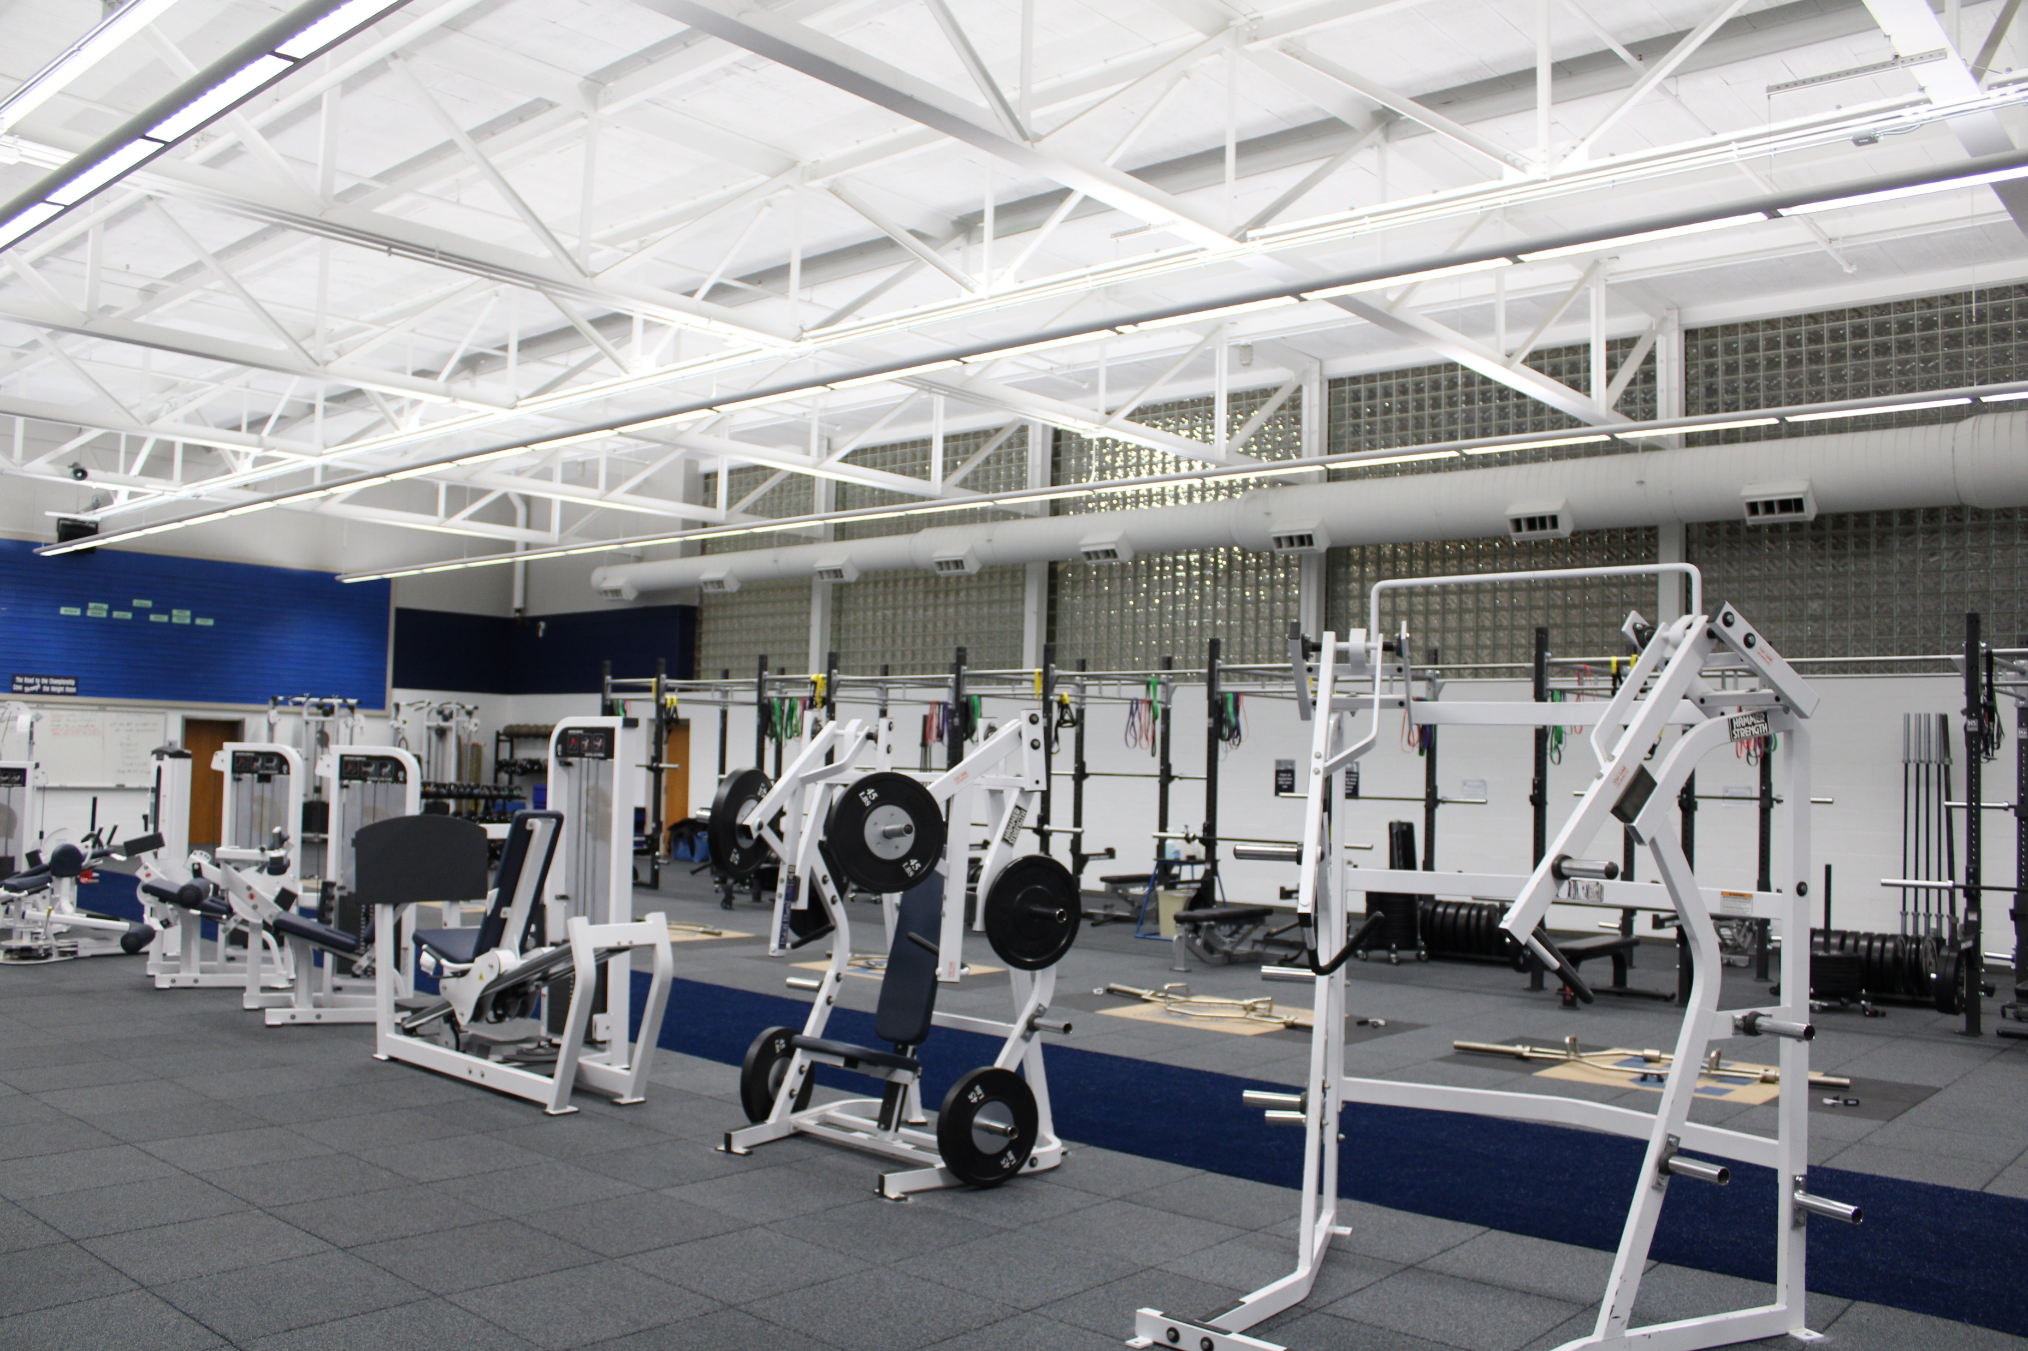
Interscholastic Athletic Overview
30 Athletic programs
79 Teams
120 Coaches and volunteers
Facilities
22 Outdoor fields (HS/MS)
12 Tennis courts
3 Gymnasiums (HS/MS)
2 Fitness centers
1 Pool
1 8-lane track
Notes:
21 outdoor athletic fields on HS and MS campuses
3 gymnasiums in HS and MS
1 high school pool
2 fitness centers
Approximately 120 coaches (including unpaid/BOE approved volunteers)
30 athletic programs (ie. boys basketball, girls basketball, girls tennis, boys tennis...)
78 individual athletic teams (ie. varsity boys basketball, JV boys basketball, modified A boys basketball, modified B boys basketball, etc.)

Slide 72
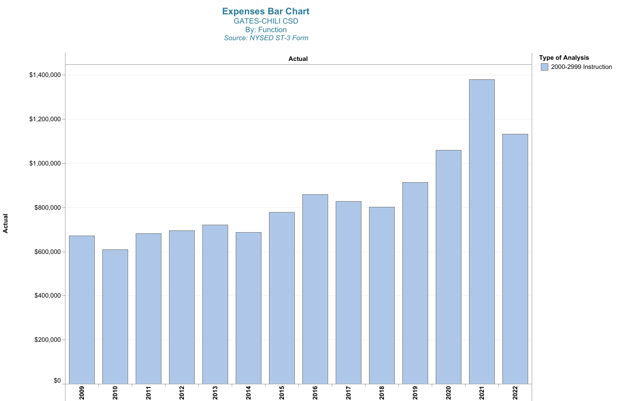
Athletics Expense History
Notes:
2021 includes budgeted Weight Room Equipment Purchase at approx. $300K. sjs

Slide 73
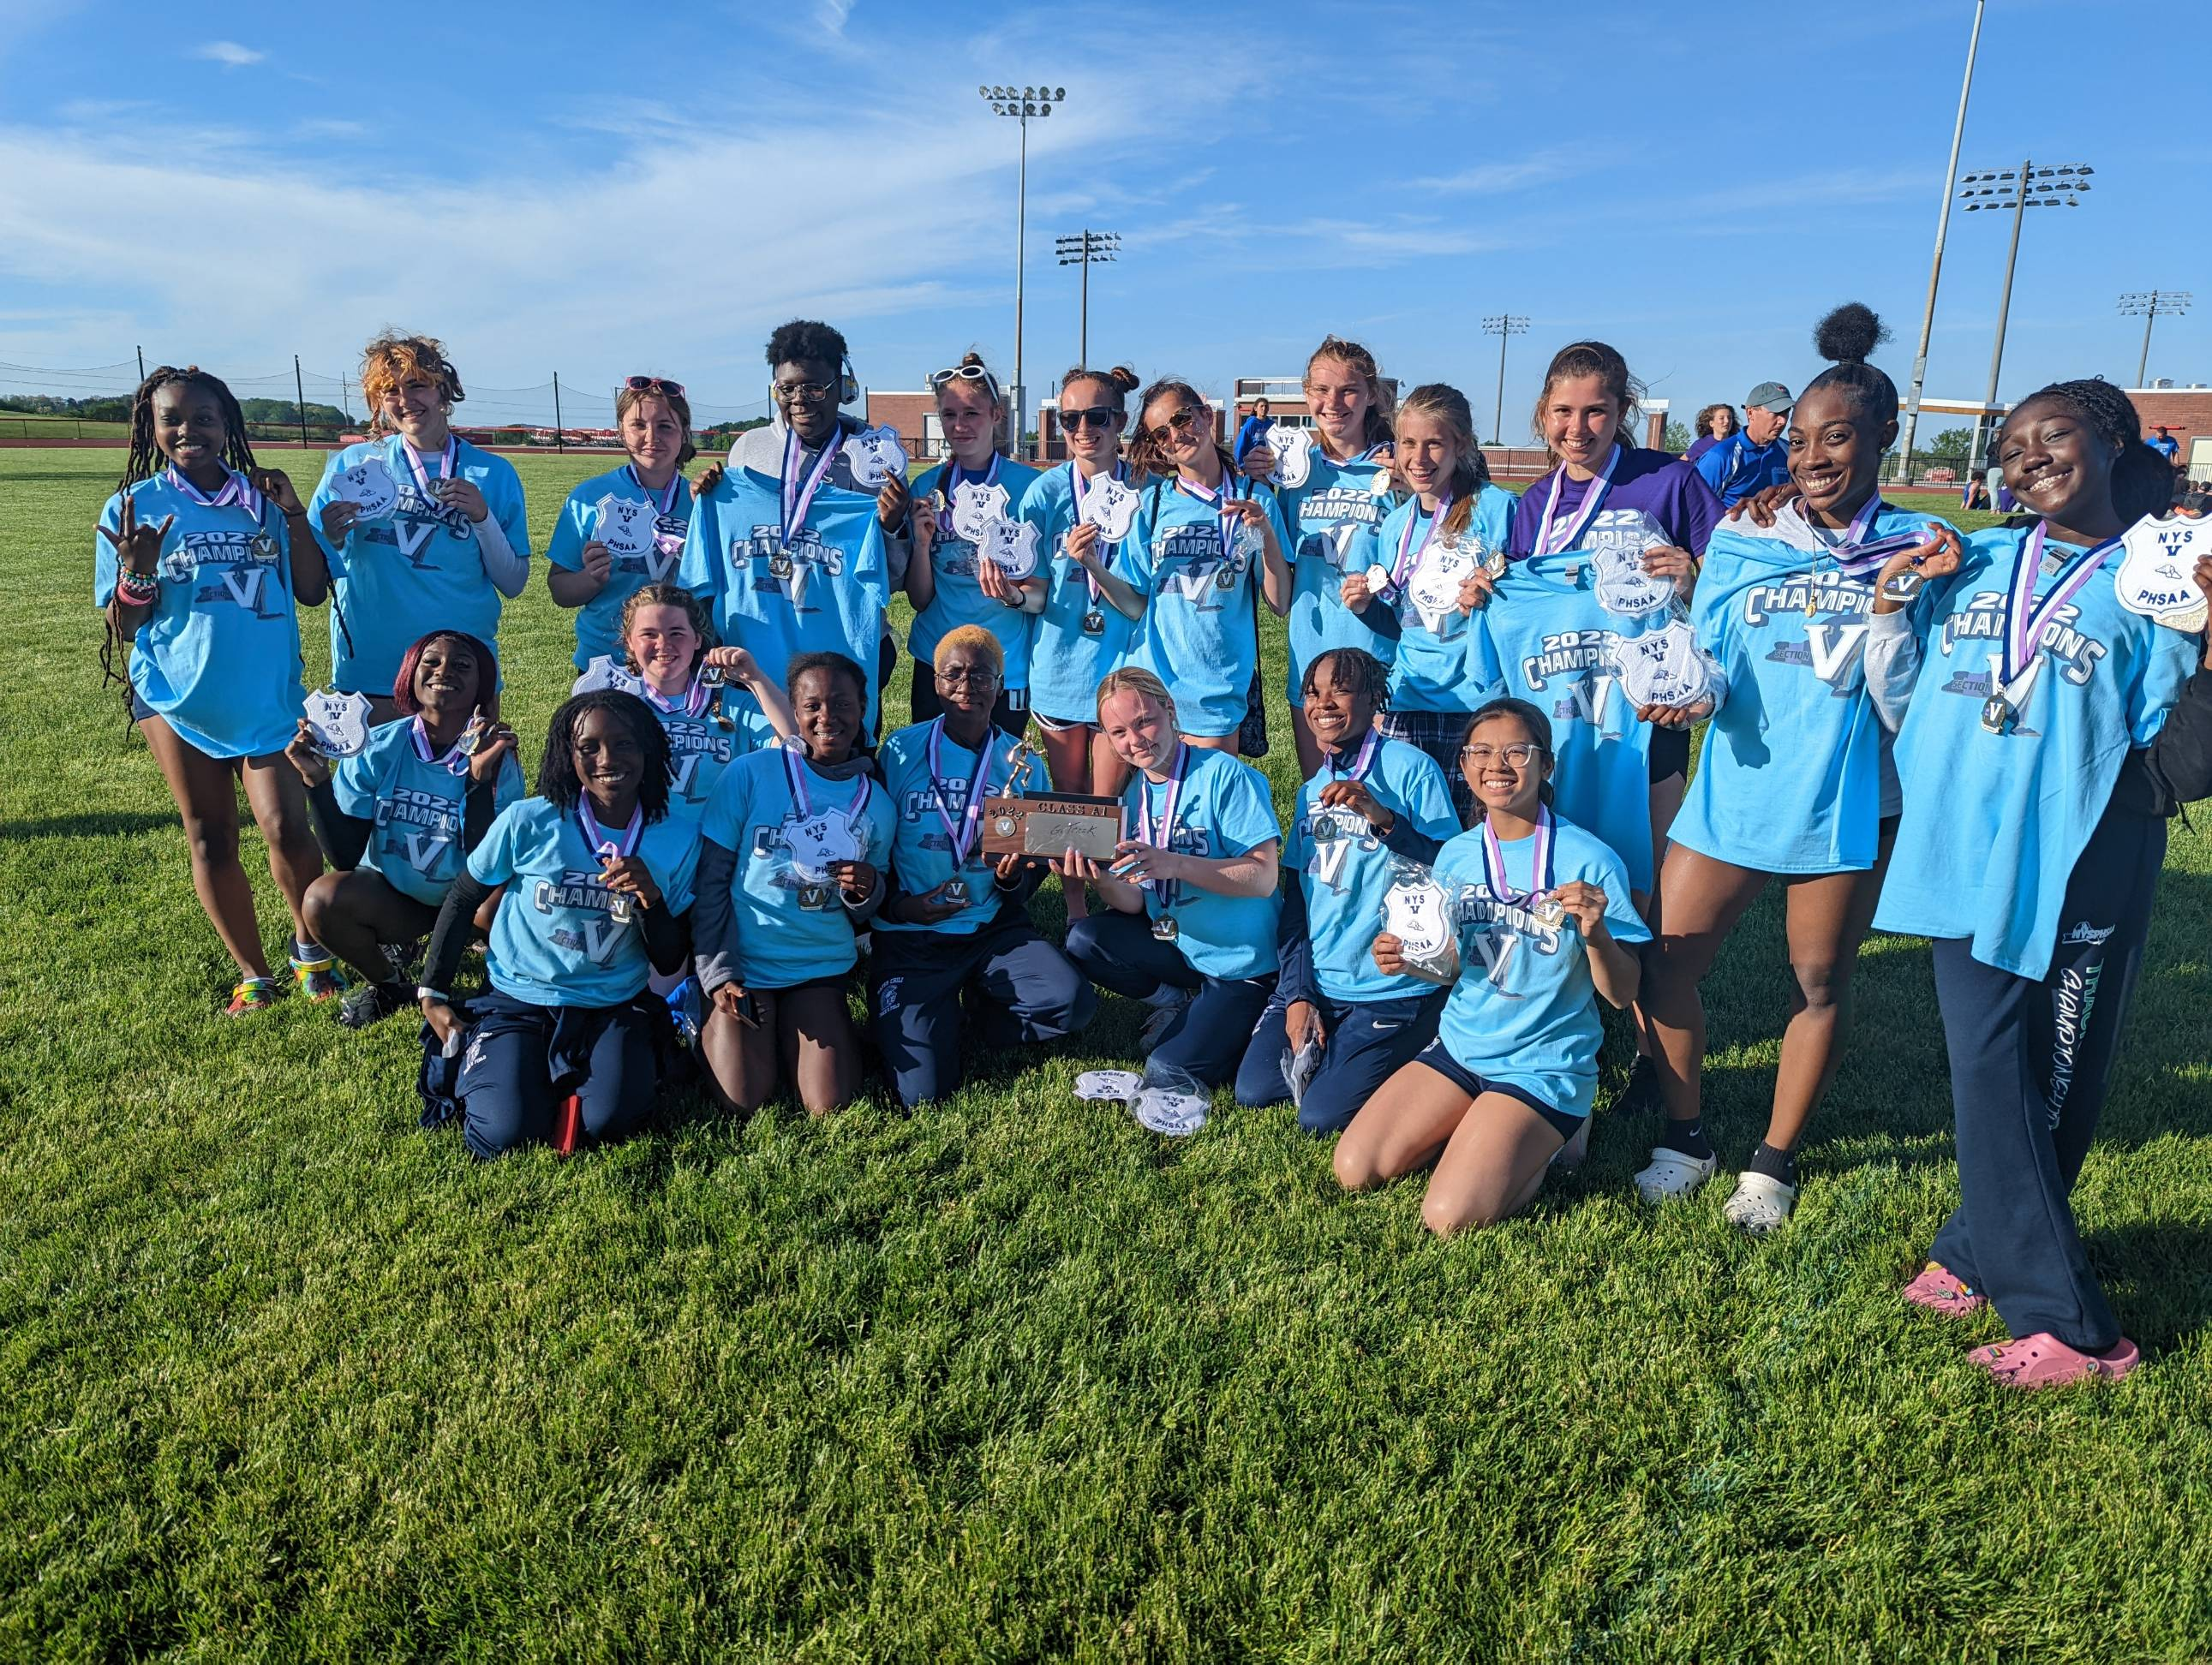
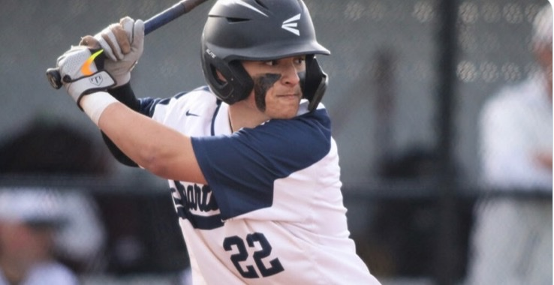
Athletics Department Budget
2023-24 Budget: $ 1,451,505
2024-25 Est. Budget: $ 1,481,742
Still have not finalized projections
Approximately 1.11% of overall budget
Notes:
Coaching reduction
Function 2855

Slide 74
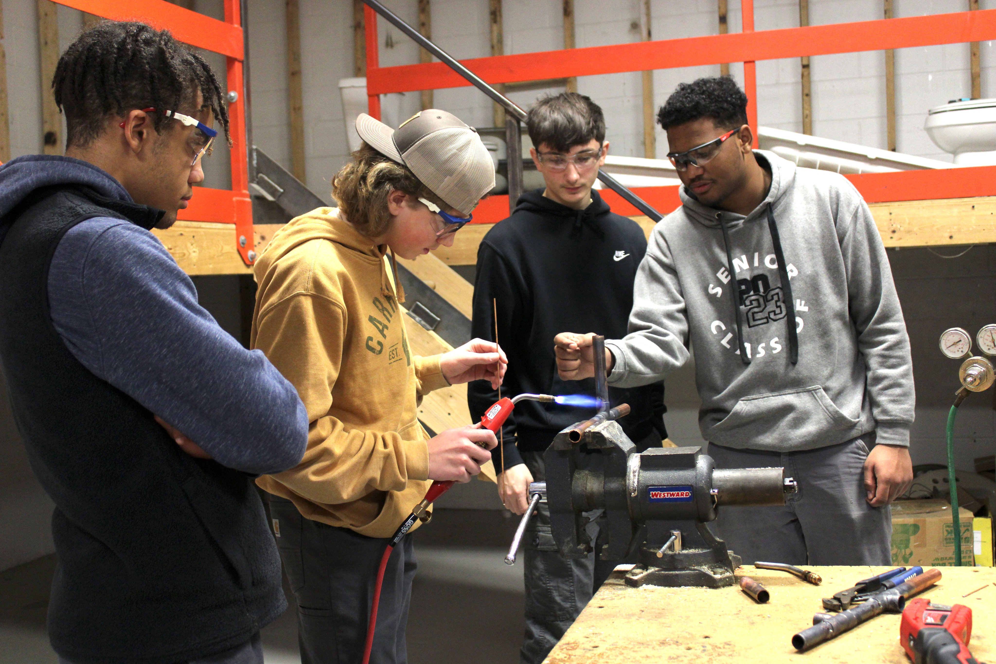
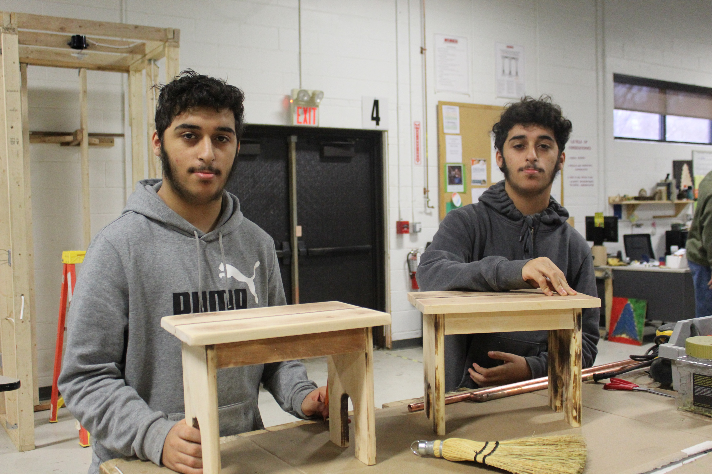
BOCES Services
Board of Cooperative Educational Services
Allows us to collaboratively purchase supplies and share services with other districts across the region and state
Presently, we are still developing this budget:
Estimating a 5% increase across the board
Current 2023-24 Budget: $15.6M
Percent of Overall Budget: 12.37%
Notes:
We are in the Monroe 2-Orleans BOCES region. Other districts … but, we can contract for services with other BOCES and districts throughout the state by entering into something called a cross contract.

Slide 75
Special Education Budget
2023-24 Budget: $18,436,783
2024-25 Est. Budget: $19.4M – $20M
Budget: Still being finalized
Currently, around 14.6% of overall budget
Still working on this budget
Mandated programs must program (pay) for
Student needs determined once evaluation for the year is complete
Populations are transient
Kindergarten needs are still being determined
Notes:
Remember! This is only the General Fund. We are not reducing services. Services are on the rise. Moved personnel costs to IDEA 611/619 & Federal Funds
Includes 2250 (Special Education)
Increase of $995,442 increase of 5.3%
No 2271 codes

Slide 76
Technology Overview
1 Director of Technology
12 Staff members (Full Time MMT in each building)
2 vacant positions
880+ Staff devices
3,700+ Student laptops
4,500+ District e-mail addresses
150+ Applications
100+ Printer devices
410+ Wireless access points
110+ Switches
710+ Phones
400+ Samsung IWB and classroom tech
Notes:
This is what I received from him..
Updated every classroom with a state of the art, Samsung interactive display and a new desktop computer
Updated teacher devices to support the latest technology available to educators
Continuing to replace antiquated hardware software
For the first slide, I would remove the line about innovation coaches, as they are under the office of instruction now
Change smart boards to Samsung Interactive Displays

Slide 77
Technology Budget
2023-24 Budget: $ 2,570,317
2024-25 Est. Budget: $ 2,526,065
Function Codes:
1680 = Central Processing
2630 = Computer Assisted Instruction
1.9% of overall budget

Slide 78
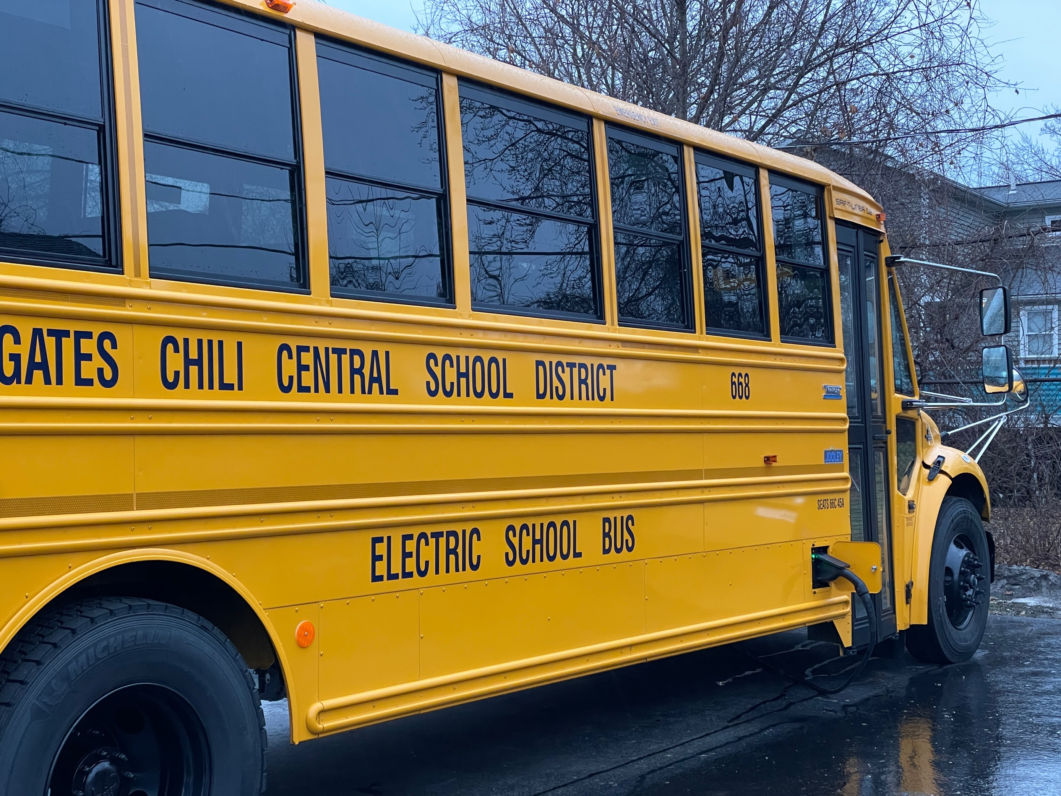
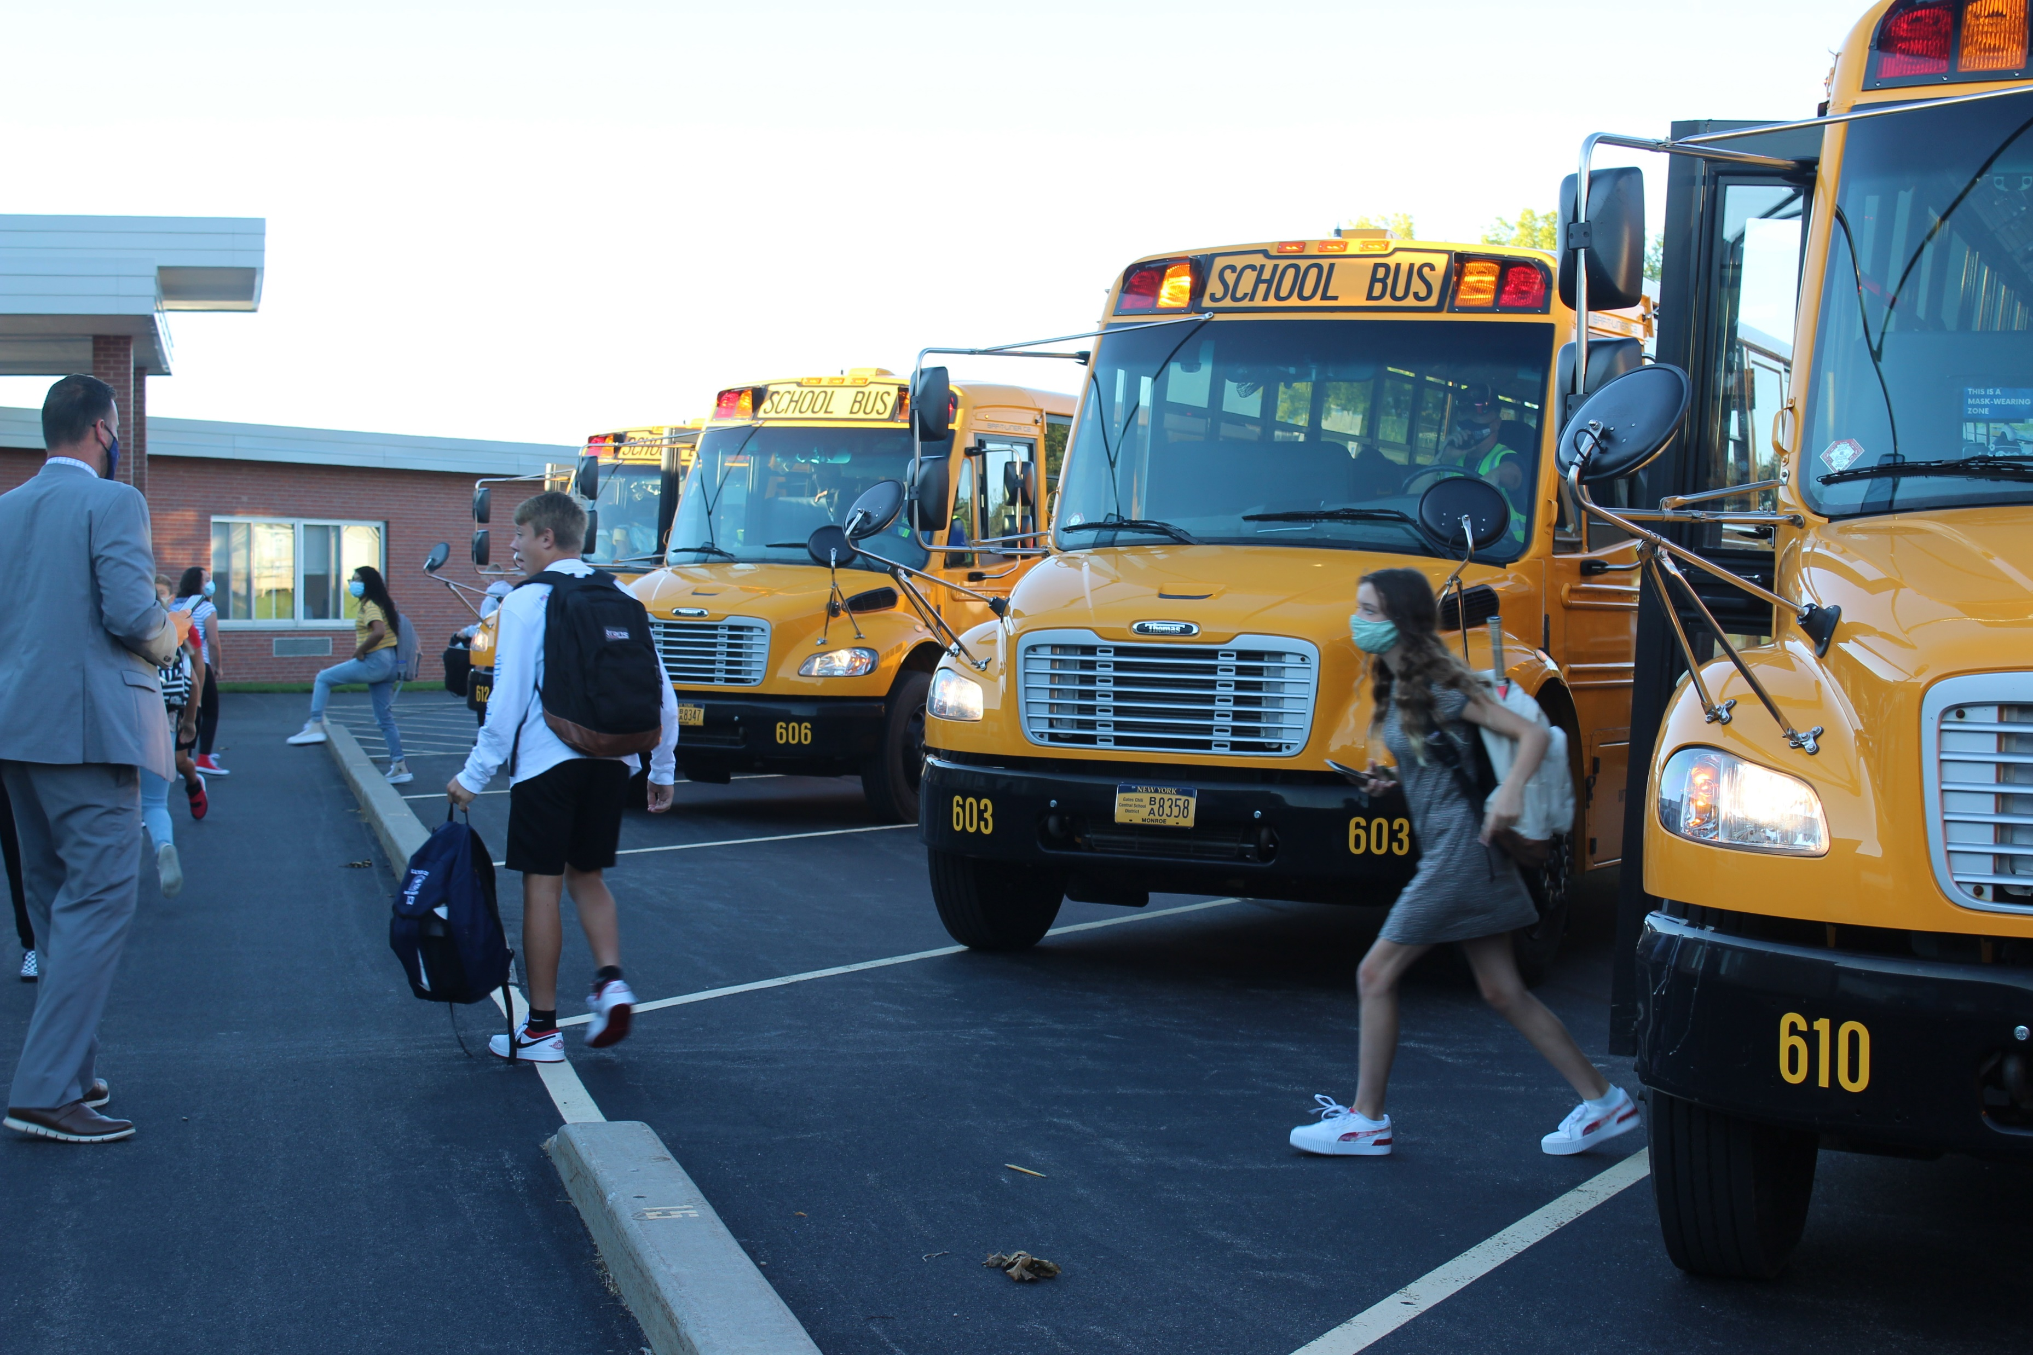
Transportation Overview
Square miles the district | 18
Miles driven each year | 1,080,710
Daily routes | 63
Trips per day | 361
Out-of-district transport location | 80
Drivers' positions | 80
Attendant positions | 24
Mechanic/supervision positions | 10.5
Number of buses | 88
Notes:
Positions: 4 Mechanics, 1 Lead Mechanic, 1 Mechanic Helper, 4 Head Drivers, 1 Director

Slide 79
Transportation Data 2023-24
 | Trips per Day | Annual Cost | Students | Annual Cost per Student
In District | 229 | $ 3,886,588 | 3,616 | $ 1,075
Private | 30 | $ 509,160 | 168 | $ 3,031
Charter School | 20 | $ 339,440 | 62 | $ 5,475
Special Education | 67 | $ 1,137,124 | 128 | $ 8,884
Out-of-District McKinney-Vento | 15 | $ 254,580 | 26 | $ 9,792
Operating Cost per Trip/Year: $16,972 ($94.29 per each trip)
No change from the 2023-2024 school year.
Notes:
These are the transport counts not the Gates Chili student count. The amount increase from 2020-2021 to 2022-23 because of COVID (# of runs and student less) plus the $2 raise which occurred.

Slide 80
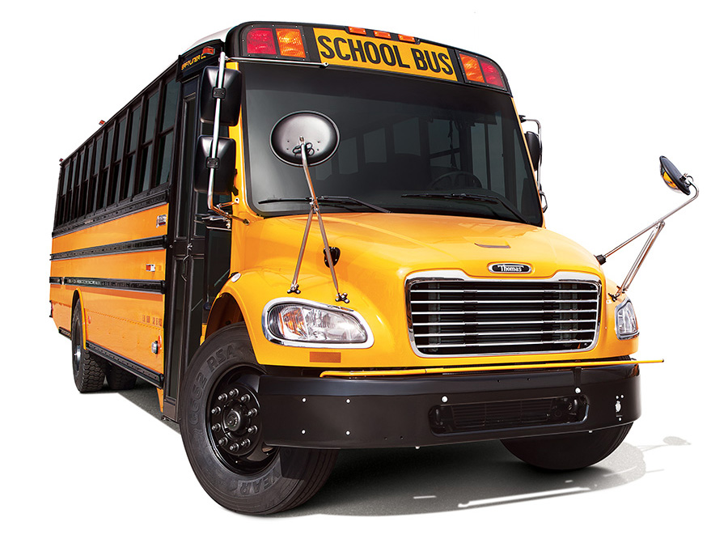
Bus Replacement Philosophy
A six-year bus replacement schedule is in place to ensure the highest safety standards and to preserve long-term cost savings.
We typically replace 14-15 buses per year, maintaining our nearly 90-bus fleet.
Notes:
We take health and safety very seriously. We have done a lot as a district to ensure we’re at the top of the pile when it comes to safety for our students. At the March 10 BOE meeting, Matt and George will talk about our high standard for safety.

Slide 81
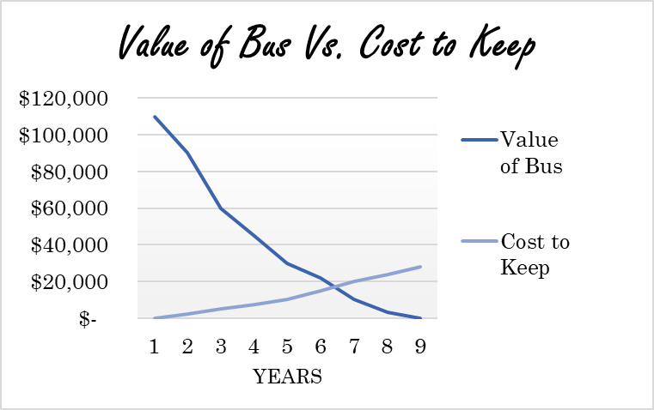
Bus Replacement
Philosophy: To maintain a six-year bus replacement schedule, ensure the highest safety standards, and preserve long-term cost-savings.
Main Priority: High safety standard
State Reimbursement: For every dollar spent, Gates Chili CSD receives approximately 75 cents in reimbursement from New York State
2024-25: Diesel & Eclectic purchases
Sweet Spot for Purchasing New Buses:
~ 6 Years

Slide 82
Electric School Bus Purchases
Gates Chili is planning to purchase ten (10) electric school buses (ESBs) for the 2024-25 school year.
Grants are awarded by NYSERDA
Grants not approved as of Feb. 27
Notes:
Plan is to get 10 buses no grant awarded as of 2-16-2024

Slide 83
Combined Bus Replacement Totals
Total new buses: 14
Total cost: $5,086,478.58 (plus bonding fees)
Estimated trade-in value for 4 diesel buses: ($ 86,000)
Estimated grant value for 10 ESBs: ($ 2,580,500)
TOTAL: $2,419,978.58 (plus fees)
Notes:
Post Aid Cost: $600,000 = $42,857/bus… and we will still see operational costs over a conventional diesel engine bus due to not using fuel.

Slide 84
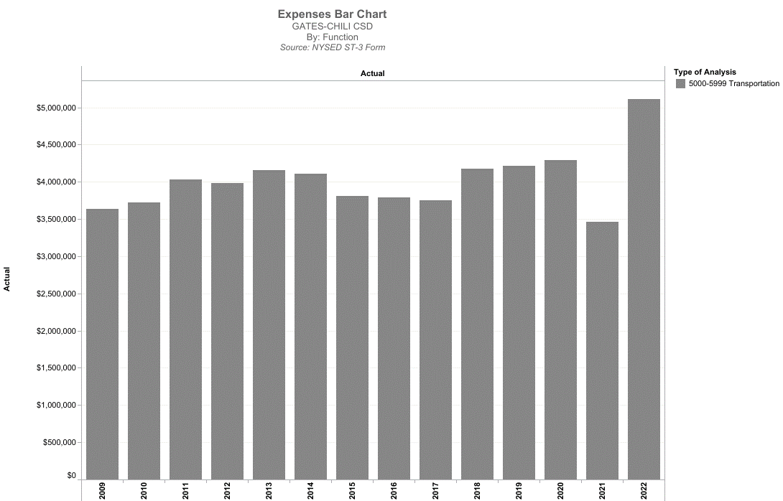
Transportation Expense Trending
COVID
Note: For Gates Chili CSD, we get 75 cents back on the dollar from New York State
Notes:
2020/2021 expense reduction due to hybrid learning model. Students remote or being driven to school.

Slide 85
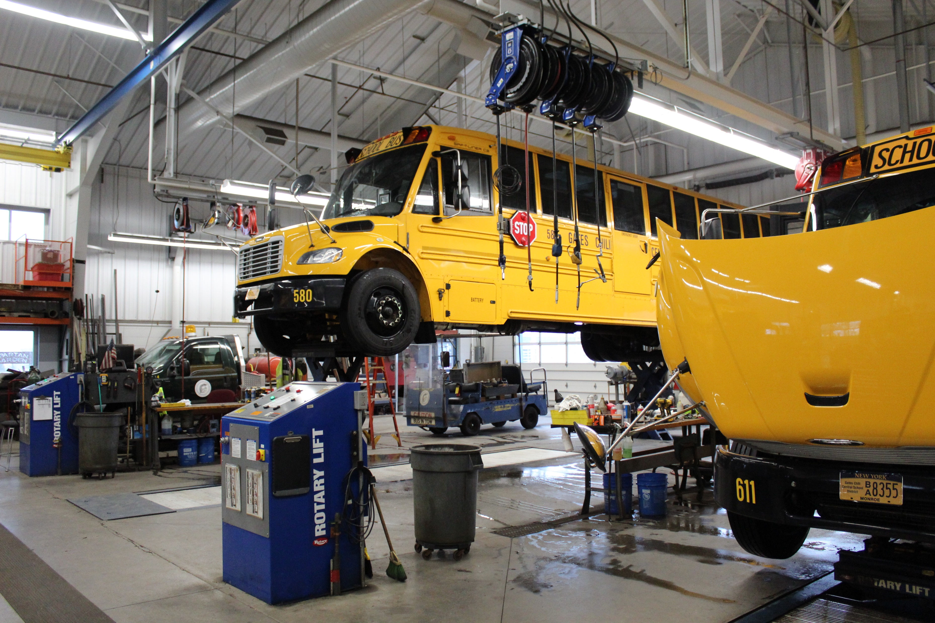
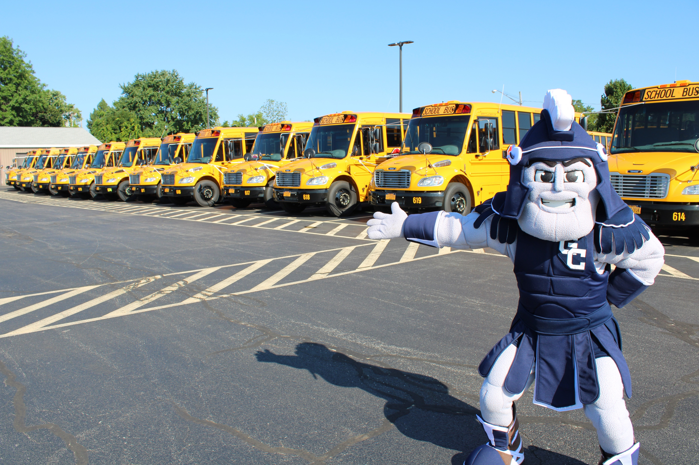
Transportation Budget
2023-24 Adopted Budget: $5,871,845
2024-25 Est. Budget: $6,067,609
Increased salaries, runs, fuel, and parts cost boosted budget by 3.3%
4.6% of 2024-2025 Total Estimated Budget
Notes:
Increase of $872,624 or 17%

Slide 86
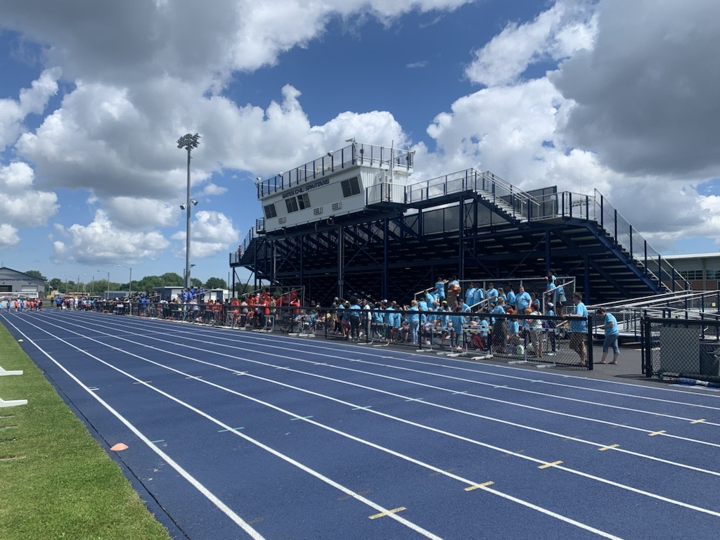
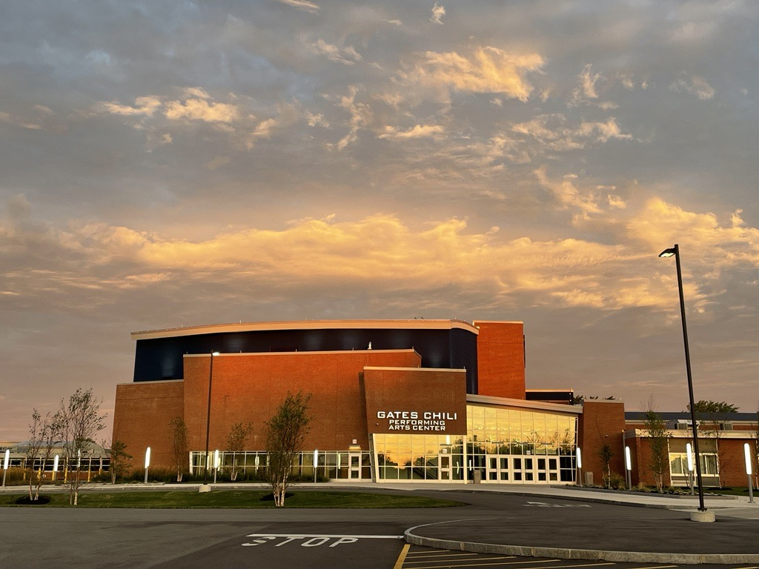
Facilities and Operations Overview
Buildings 6 Schools: 795,519 sq./ft. 7 Others: 38,631 sq./ft.
Property 230 acres
Building/grounds personnel 55
Security personnel 13
Vehicles 19
Other pieces of equipment 32

Slide 87
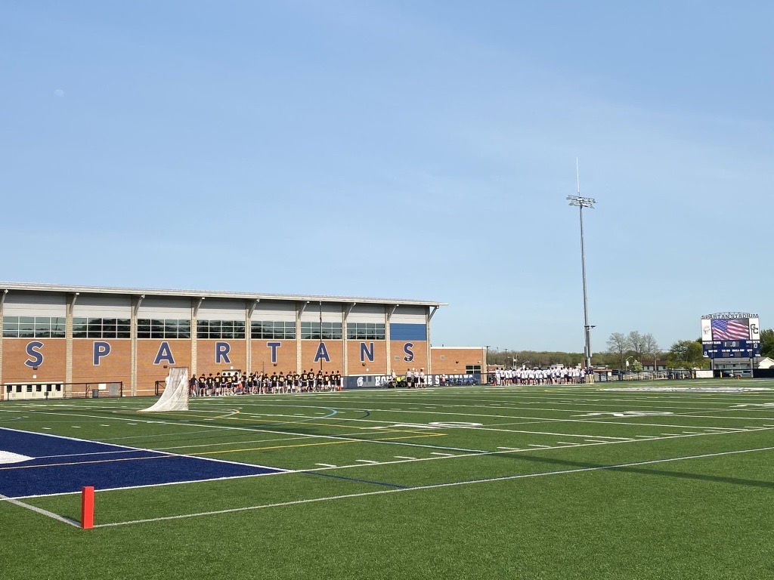
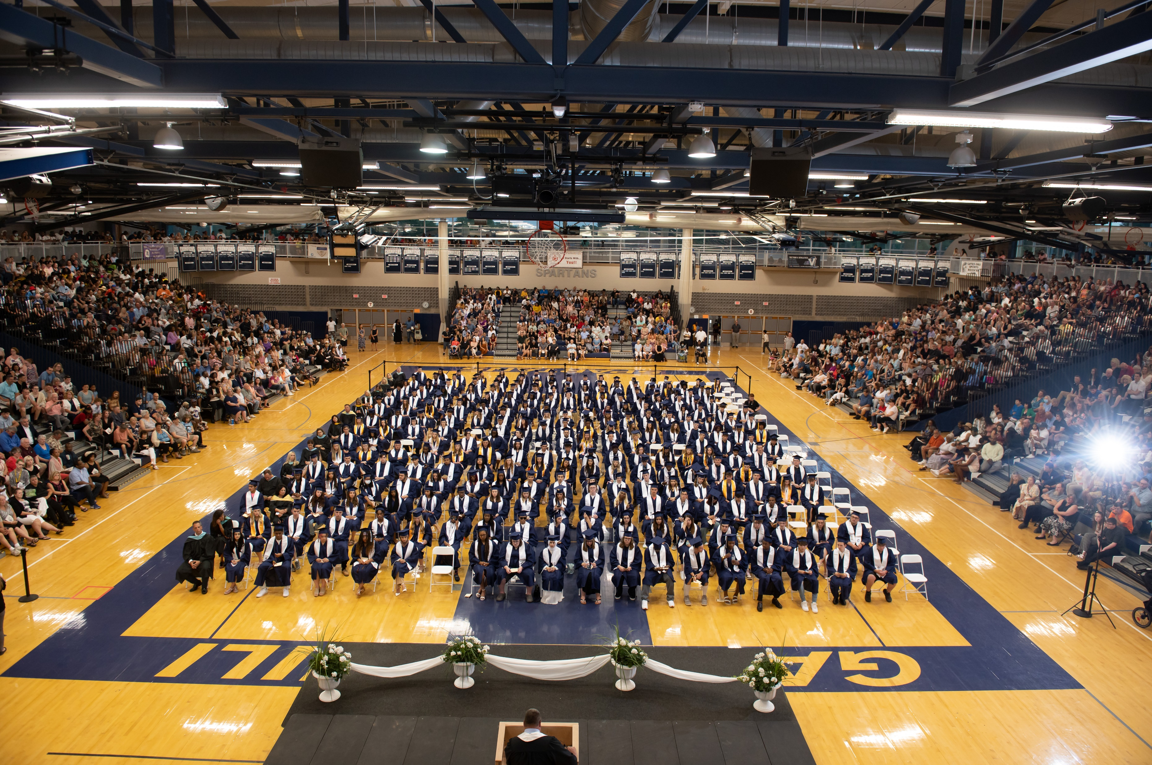
Facilities and Operations Budget
2023-24 Adopted Budget: $8,700,639
2024-25 Est. Budget: $9,237,147
Budget Increase 6.17%
Percent of Overall Budget 6.94%
Notes:
Includes Natural Gas, Electricity, Water Usage, & telephones
Major utility increase considering inflation and supply
Energy Audit indicated that we will see a major utility considering inflation and supply.

Slide 88
Debt Service – Capital Only
Notes:
Debit Service is approx. 8% of the total $133,061,1100 budget.
It is a decrease of 4.3% from the 2023-2024 SY.

Slide 89
Budget Calendar and Timeline
February To Mid March | Buildings and Departments' staffing budgets will be reviewed and finalized by the Executive
March 1 | Tax Levy limit calculation due
March 7 | Budget Ambassadors Workshop - Expenditures
March 14 | Budget Ambassadors Workshop - Revenues
March 18 | Budget presentation to Finance Committee
March 21 | Budget Ambassadors Workshop (if necessary)
March 26 | Budget and Revenue updates and Tax Rate projections were presented to the Board of Education. Approval of School Bus Proposition
April 16 | Budget Adoption by the Board of Education
May 7 | Public Budget Hearing and Meet the Candidates Night
May 21 | Annual Budget Vote and BOE Election 6:30 a.m. to 8:30 p.m. in the Spartan Field House at GCHS

Slide 90
Email us with any questions at
communications@gateschili.org
Notes:
And this presentation will be posted to the budgeting section of our website.

Slide 91
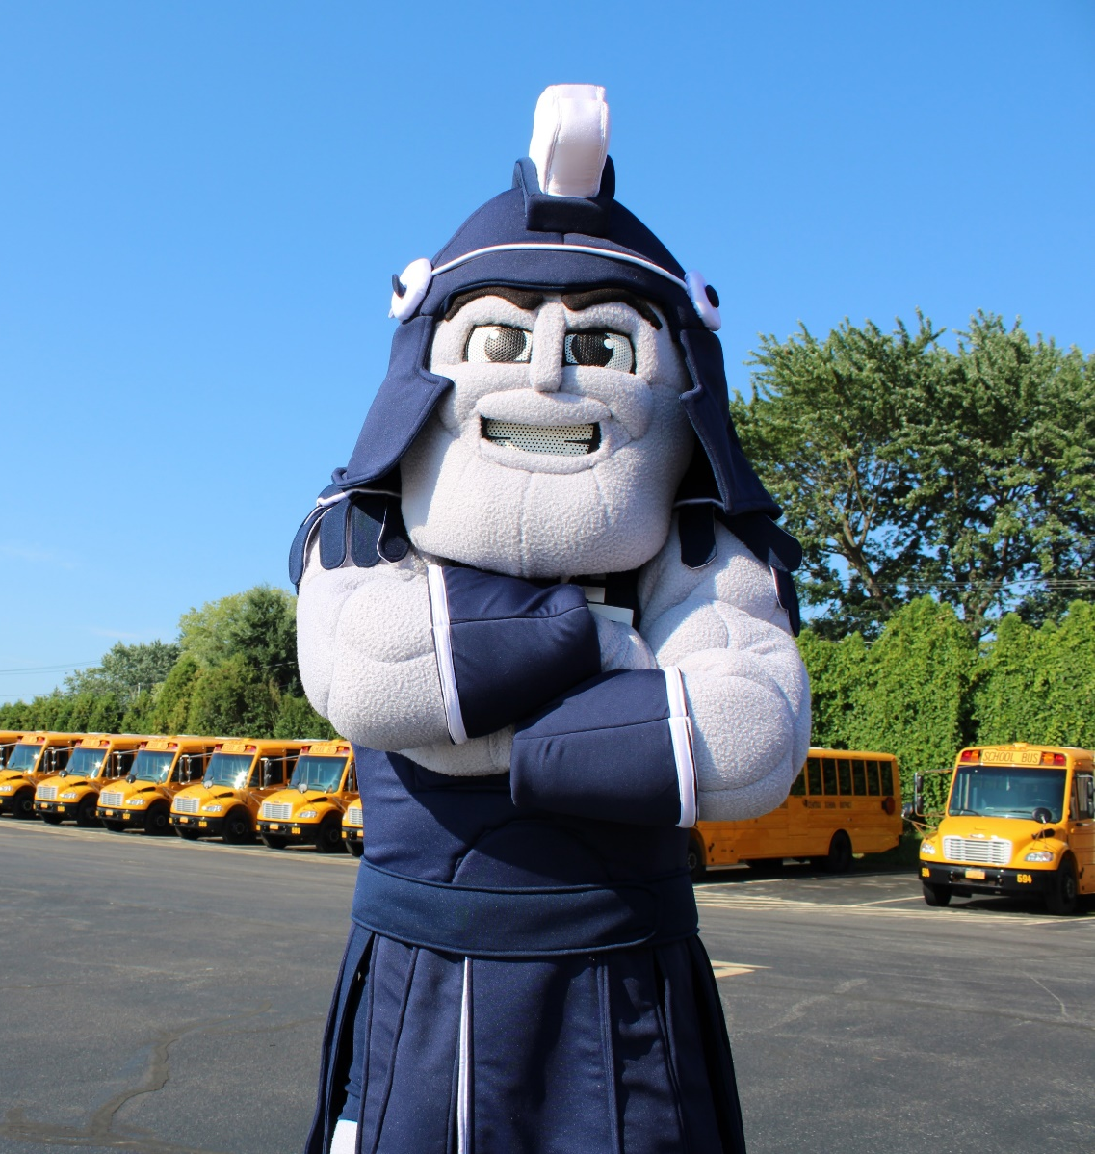
Questions?

Slide 92
Thank You!

